Slide 1
Testimonies from "Democratic Hot spots" in Asia - Civic Responses to Challenges and Threats and for International Solidarity for Inclusive Democracy for All
ASIA DEMOCRACY FORUM
Seoul
2 NOVEMBER 2015

Slide 2
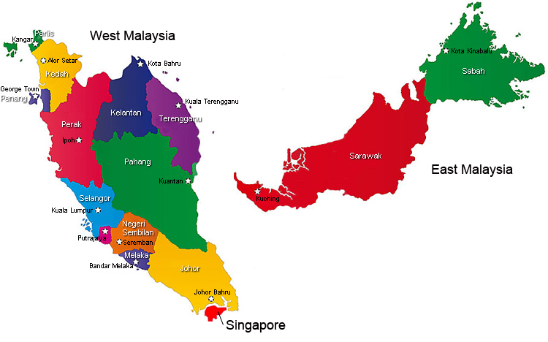
MALAYSIA

Slide 3
MALAYSIA
BARISAN NASIONAL IS CURRENTLY AMONG THE LONGEST-RULING REGIME AMONGST ALL “DEMOCRATIC” COUNTRIES AROUND THE WORLD!
THE BARISAN NASIONAL, IS JUST ABOUT THE LAST REMAINING RACE BASED COALITION AROUN THE WORLD!
ASSISTED BY AN ARMOURY OF REPRESSIVE LEGISLATION, SEDITION ACT, SPECIAL OFFENCES& SECURITY MEASURES (SOSMA), PREVENTION OF TERRORISM ACT (POTA), OFFICIAL SECTETS ACT, SHOULD NOT DESCRIBE ITSELF AS A DEMOCRACY!

Slide 4
MALAYSIA
DIVIDE AND RULE AMONG RACES. ETHNO RELIGIOUS CONFLICT ON THE RISE
ASSAULT ON INDEPENDENCE OF DEMOCRATIC INSTITUTIONS – JUDIACIARY, POLICE, ANTI CORRUPTION AGENCY
MALAYSIA’S VERSION OF RED VS YELLOW RALLIES – THE PEOPLES RESPONSE

Slide 5
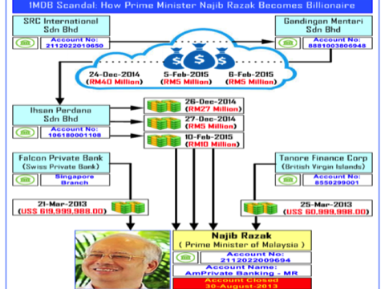
CORRUPTION – THE FUNDAMENTAL PROBLEM

Slide 6
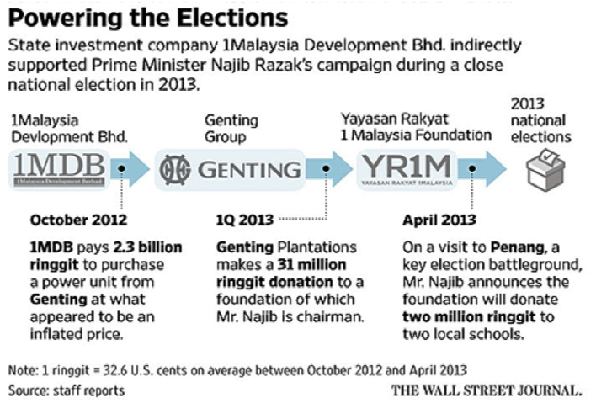

Slide 7
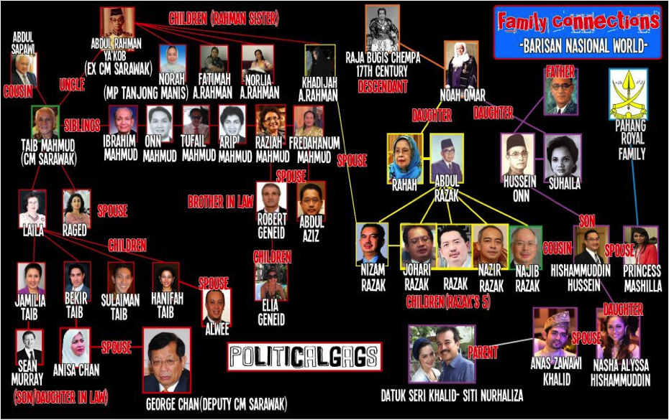


Slide 8
MONEY POLITICS & THE DEATH OF DEMOCRACY
URGENT NEED TO STRENGTHEN INSTITUTIONS
PROTECTION FOR WHISTLE BLOWERS & HRD
INTERNATIONAL MECHANISMS TO STEM FLOW OF
MONEY, TRANSNATIONAL CRIME & CORRUPTION
SUPPORT REAL DEMOCRACIES

Slide 9
CONSLUSION
DEMOCRACY WILL NOT BE ACHIEVED UNTIL WE ARRIVE AT A 2 – PARTY SYSTEM!

