Slide 1
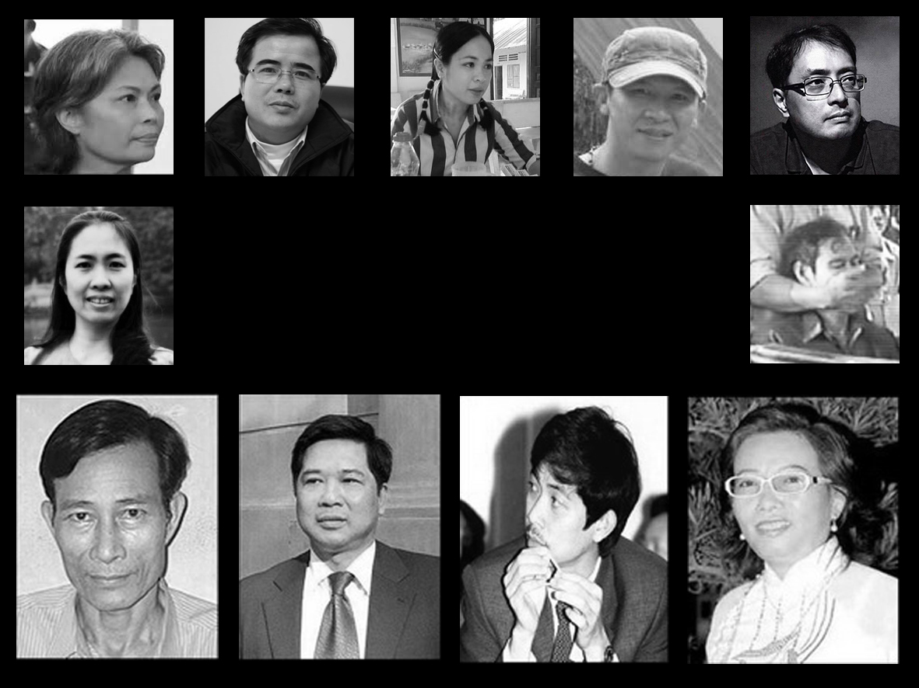
Civil Society: First Step to Democracy in Vietnam

Slide 2
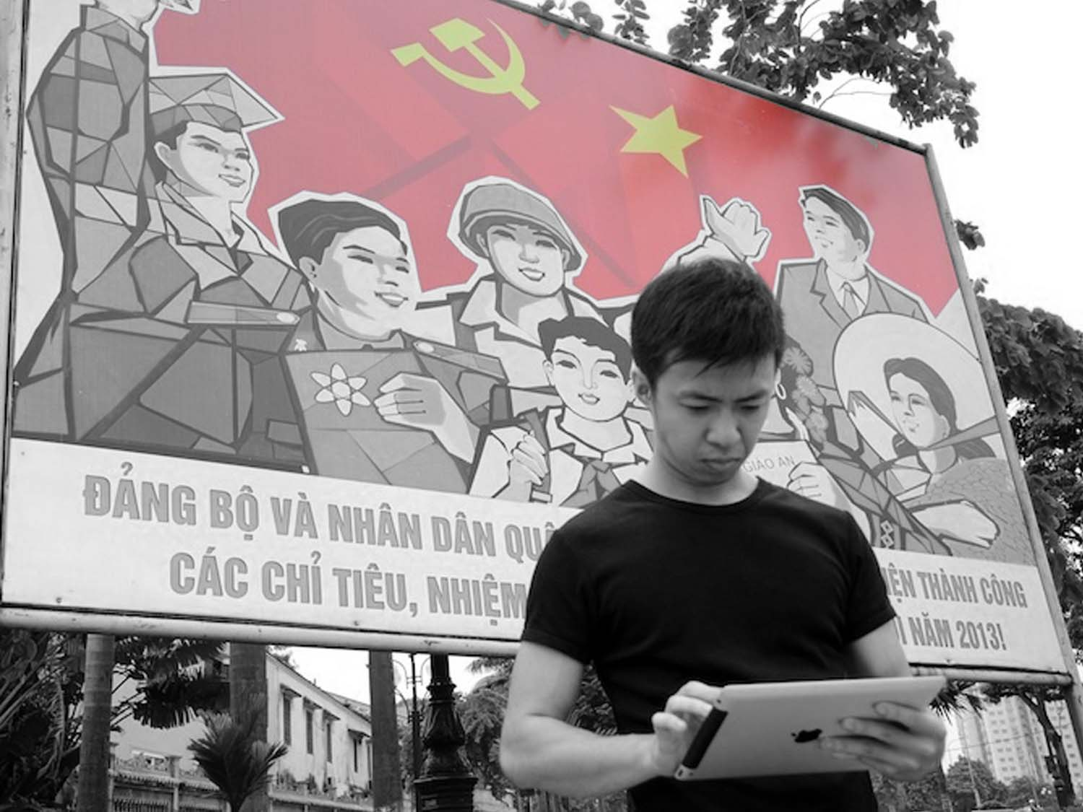
1. POLITICAL LANDSCAPE

Slide 3
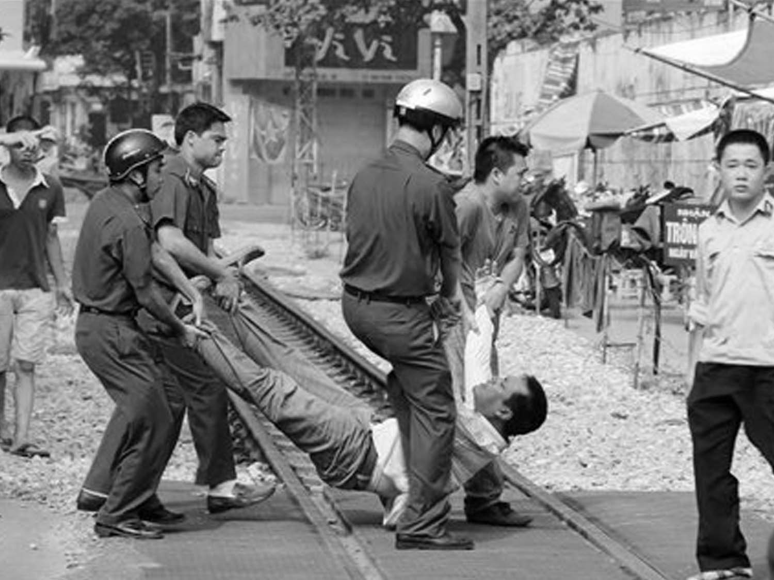
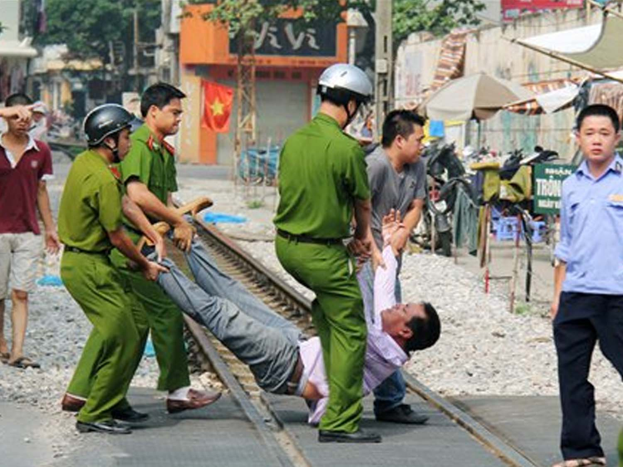
  THE 2013 AMENDED CONSTITUTION AFFIRMS CIVIL AND POLITICAL RIGHTS.
  BUT… IN PRACTICE THE GOVERNMENT HAS STRICT CONTROL OVER THE EXERCISE OF THESE RIGHTS.

Slide 4







THERE ARE APPROXIMATELY
1000 CSOs IN VIET NAM
BUT…MOST OF THEM ARE GONGOs

Slide 5

  AS A MEMBER OF THE UN HUMAN RIGHTS COUNCIL, VIETNAM WAS UNDER REVIEW DURING THE UPR PROCESS IN 2014

Slide 6
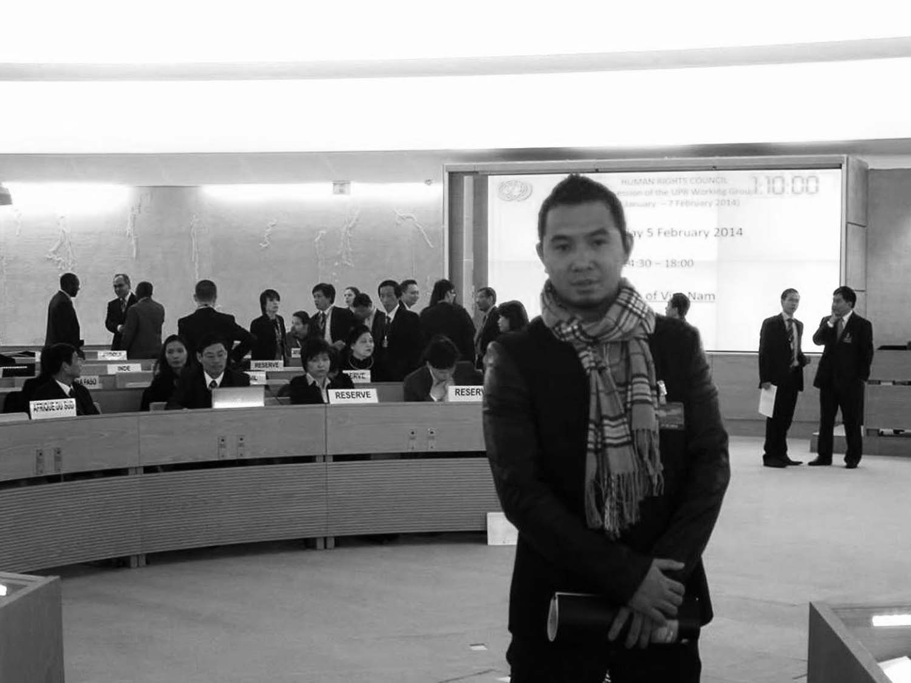



  BUT... THE GOVERNMENT RETALIATES AGAINST THOSE WHO PARTICIPATED ITS UPR SESSION.

Slide 7
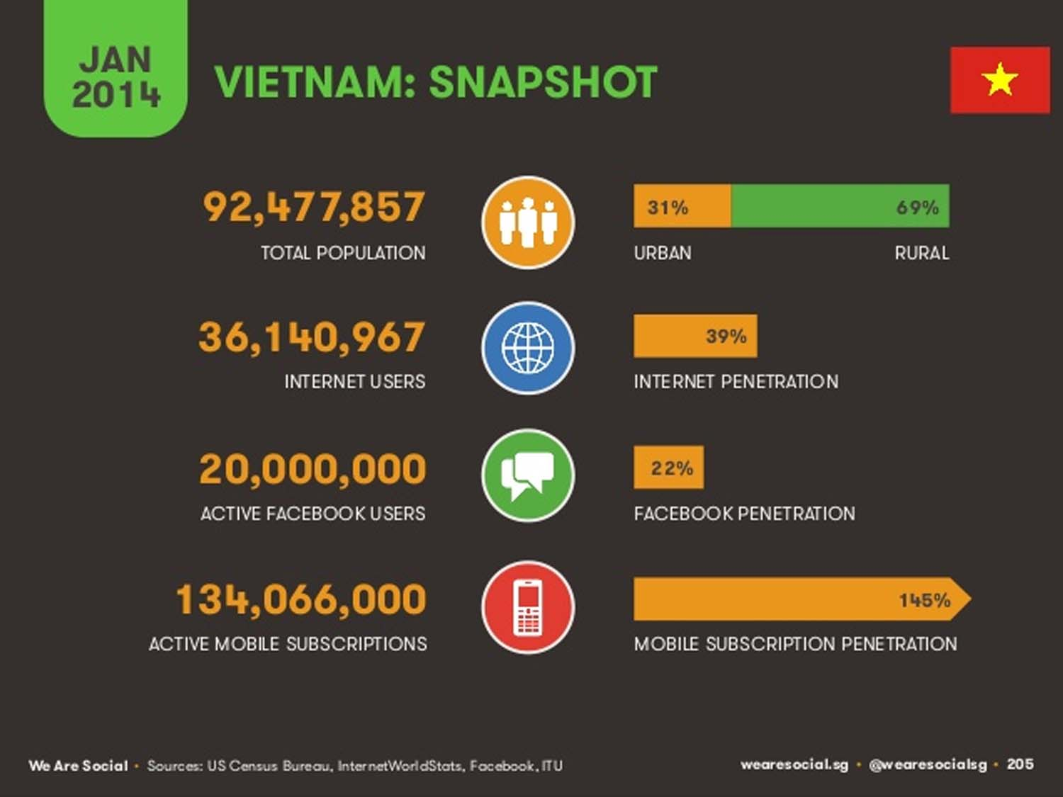

RANK 18

Slide 8
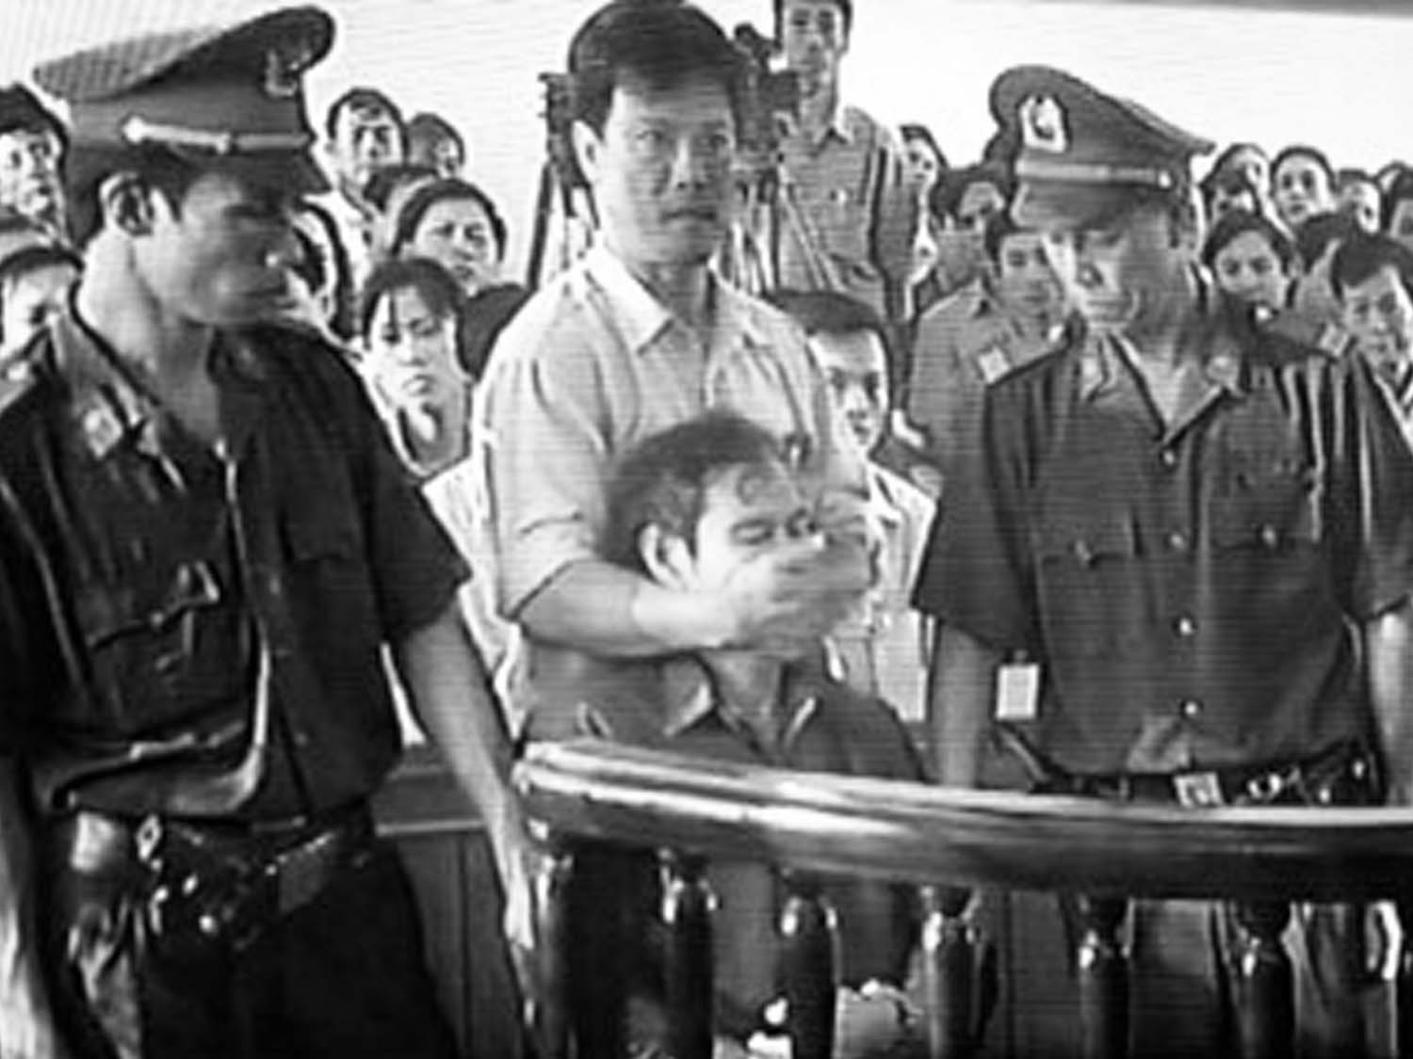
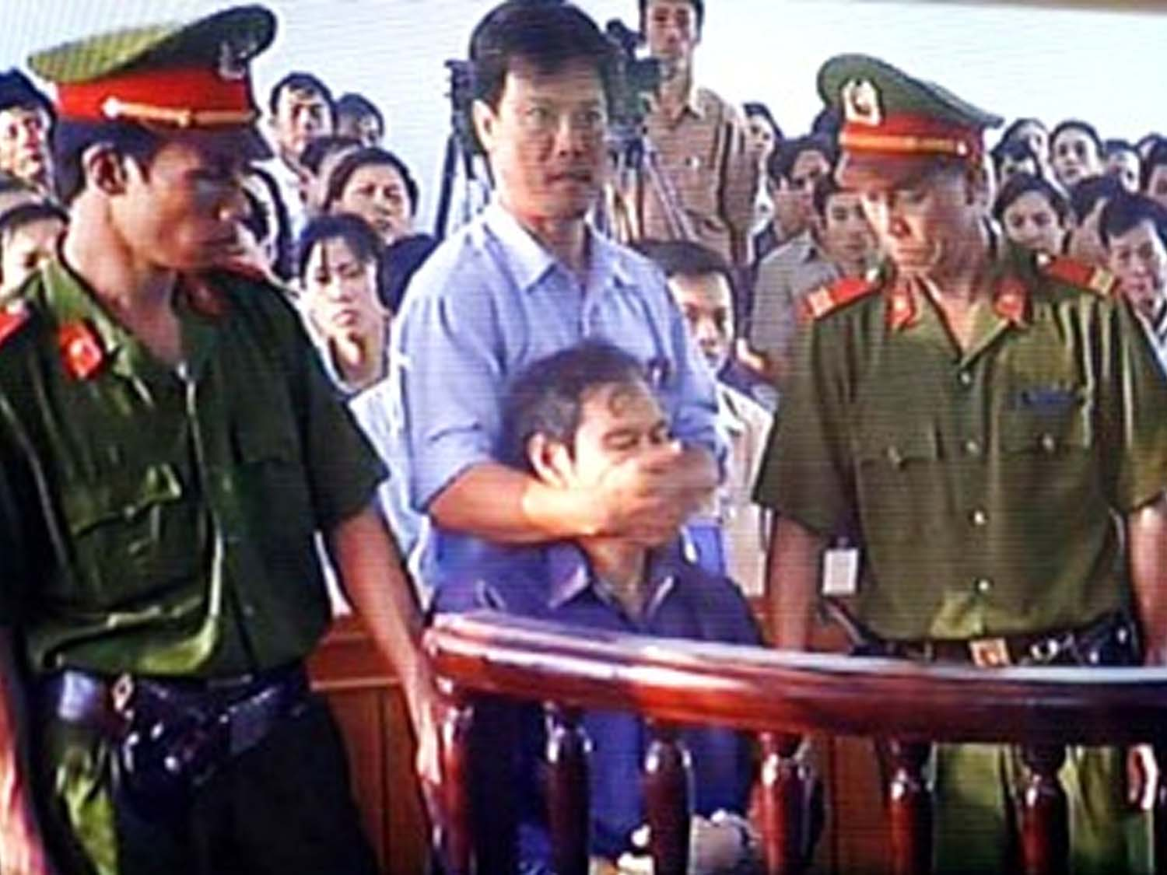
  VIETNAM IS THE SECOND LARGEST JAILER OF INTERNET USERS AROUND THE WORLD

Slide 9
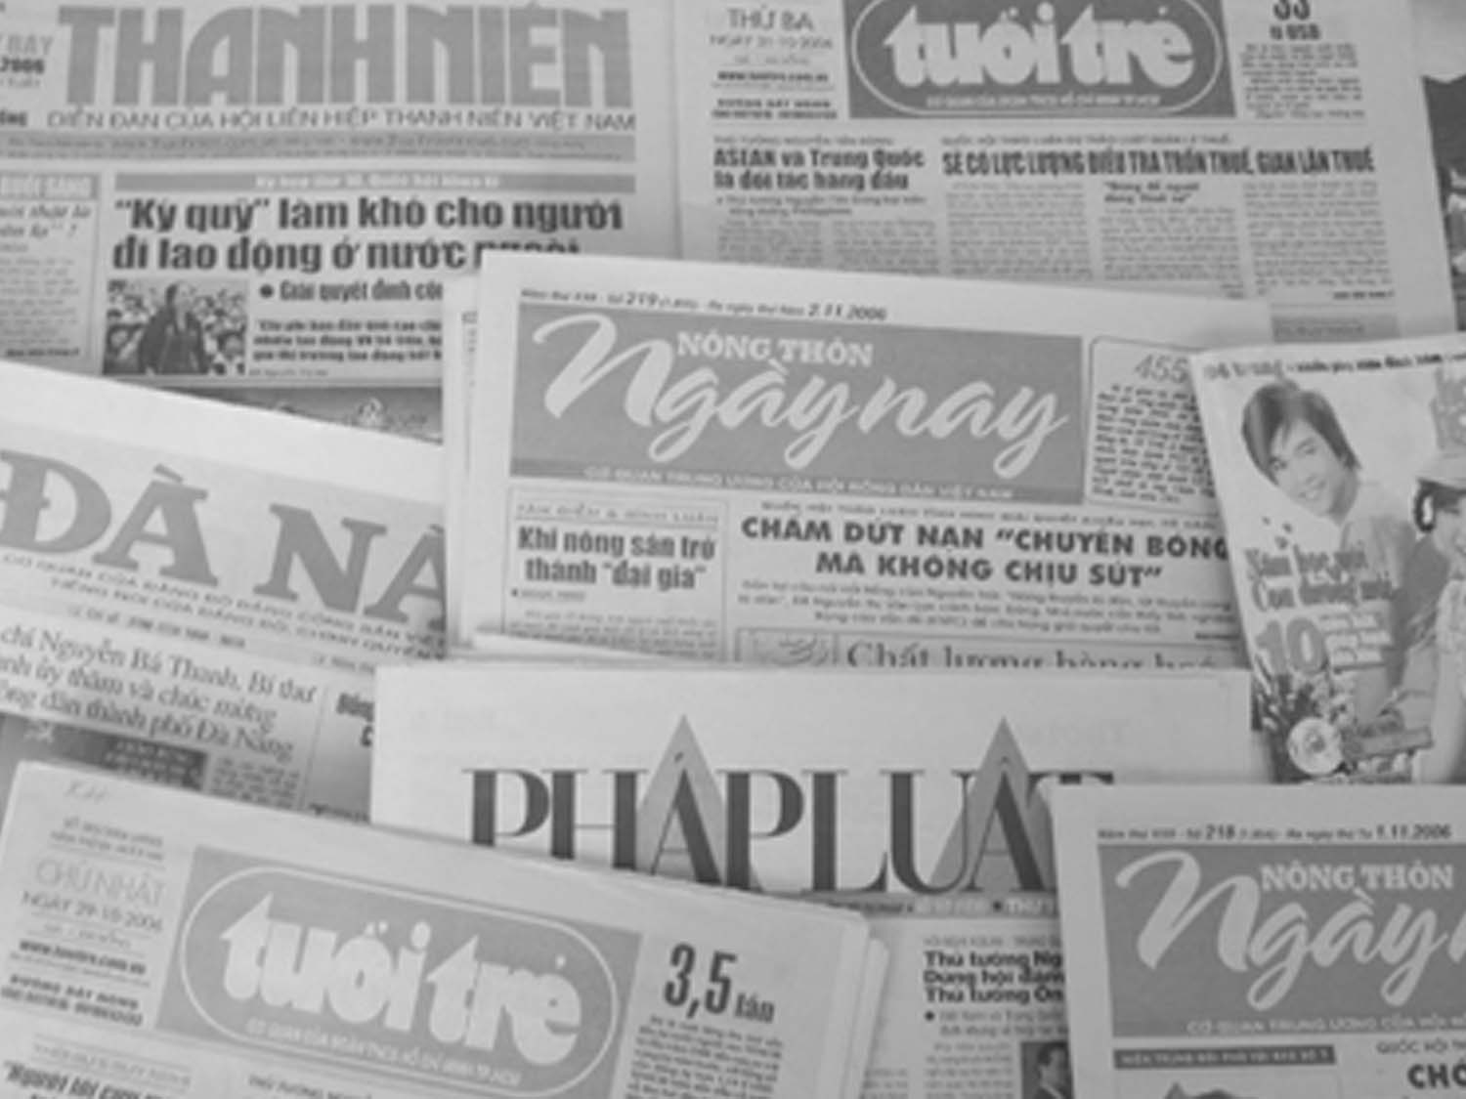
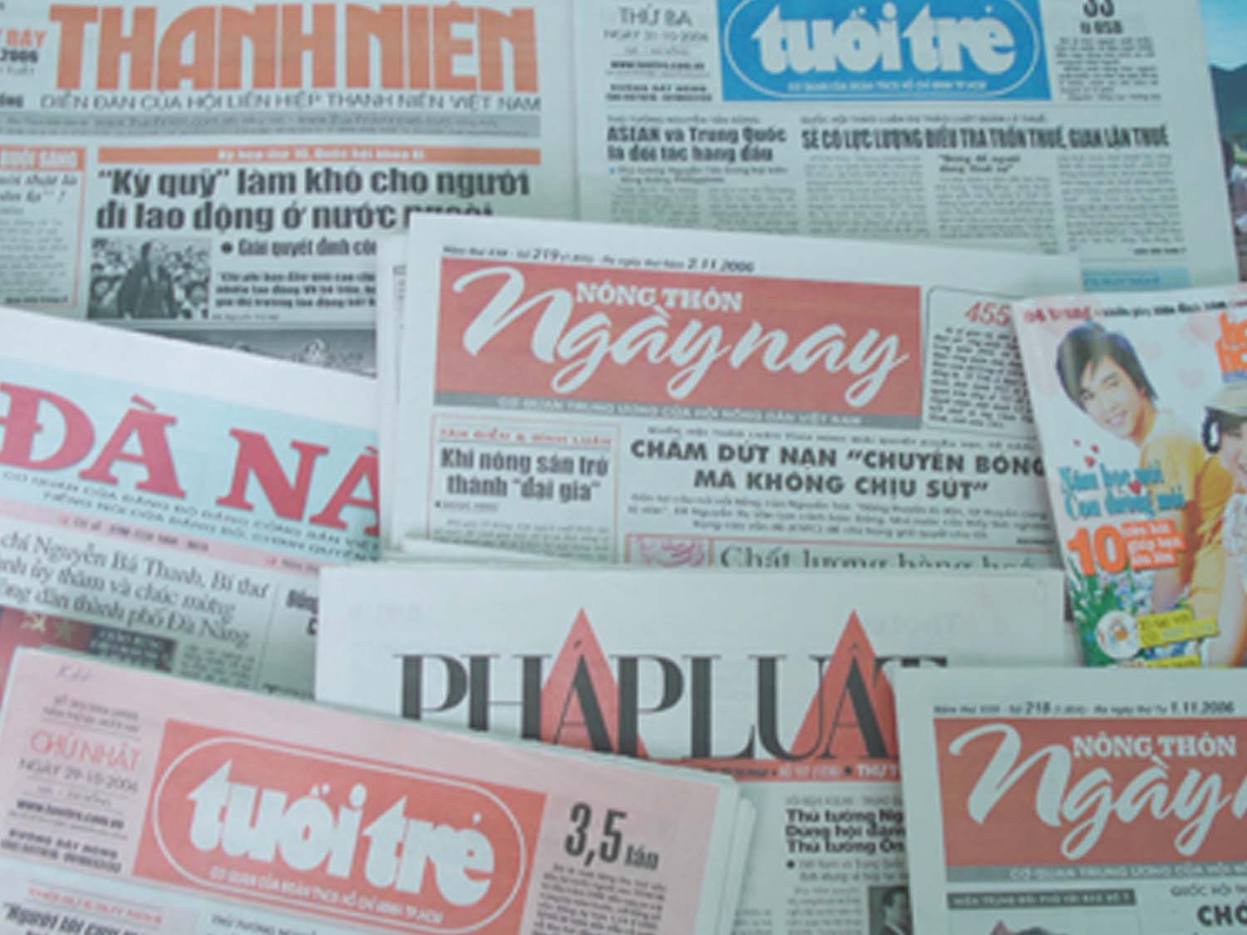
  THERE ARE ABOUT 900 NEWSPAPERS

Slide 10
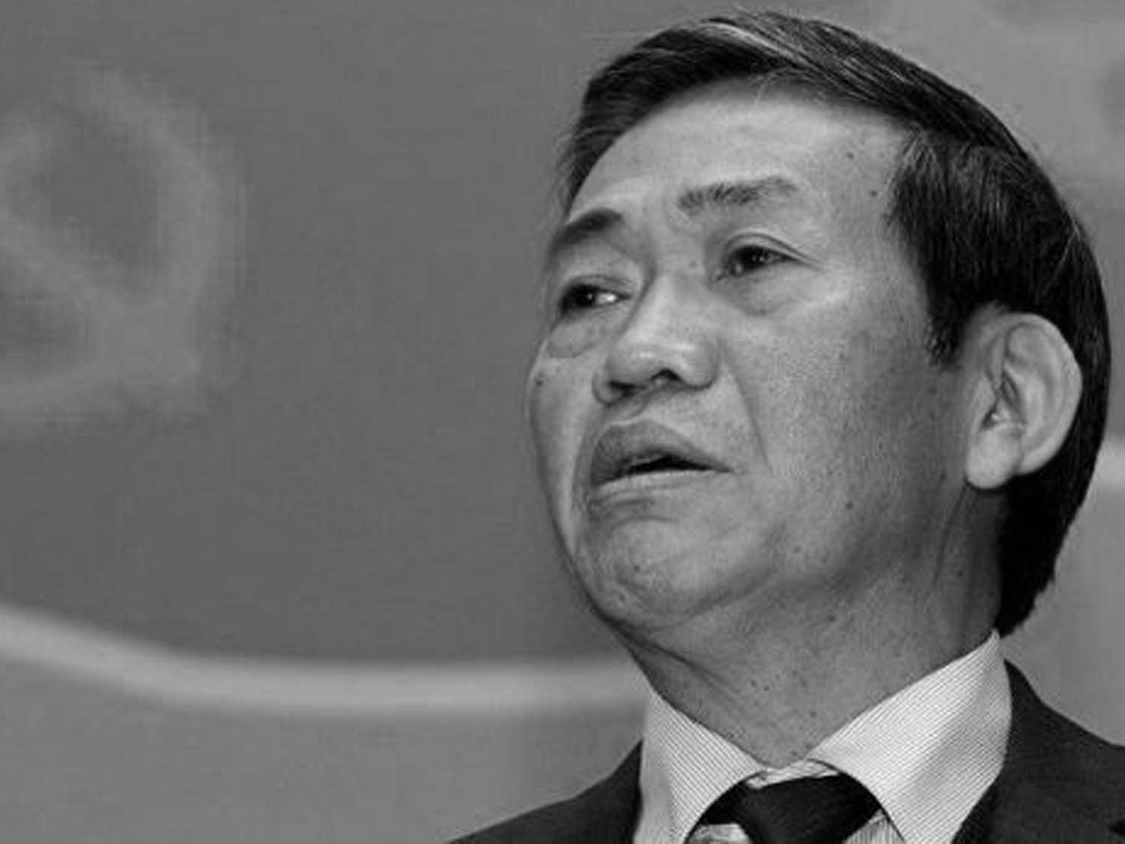
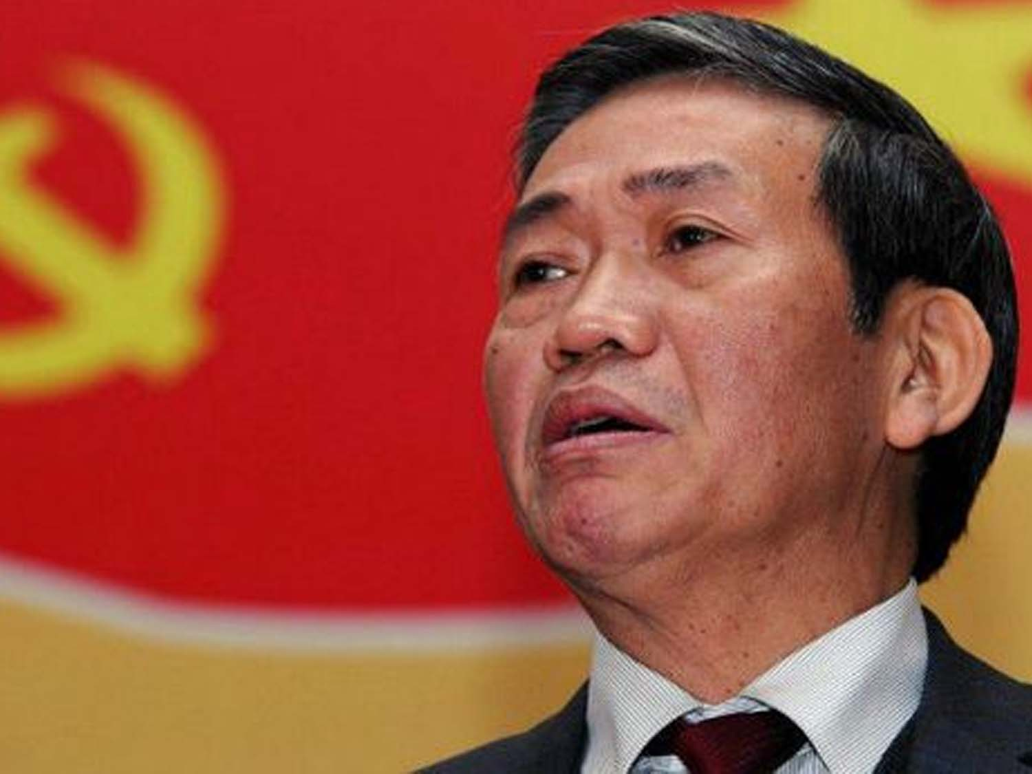
  BUT…ONLY 1 “EDITOR IN CHIEF”:
  THE HEAD OF DEPARTMENT OF PROPAGANDA OF THE COMMUNIST PARTY OF VIETNAM.

Slide 11
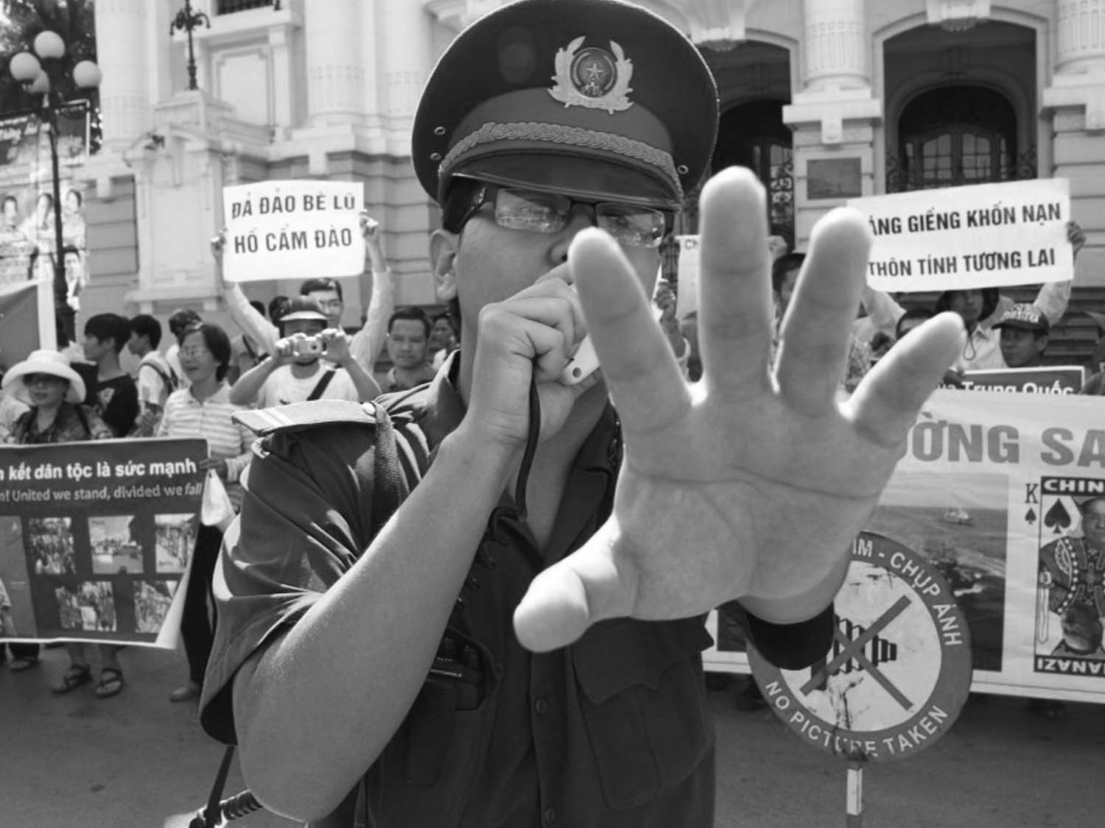
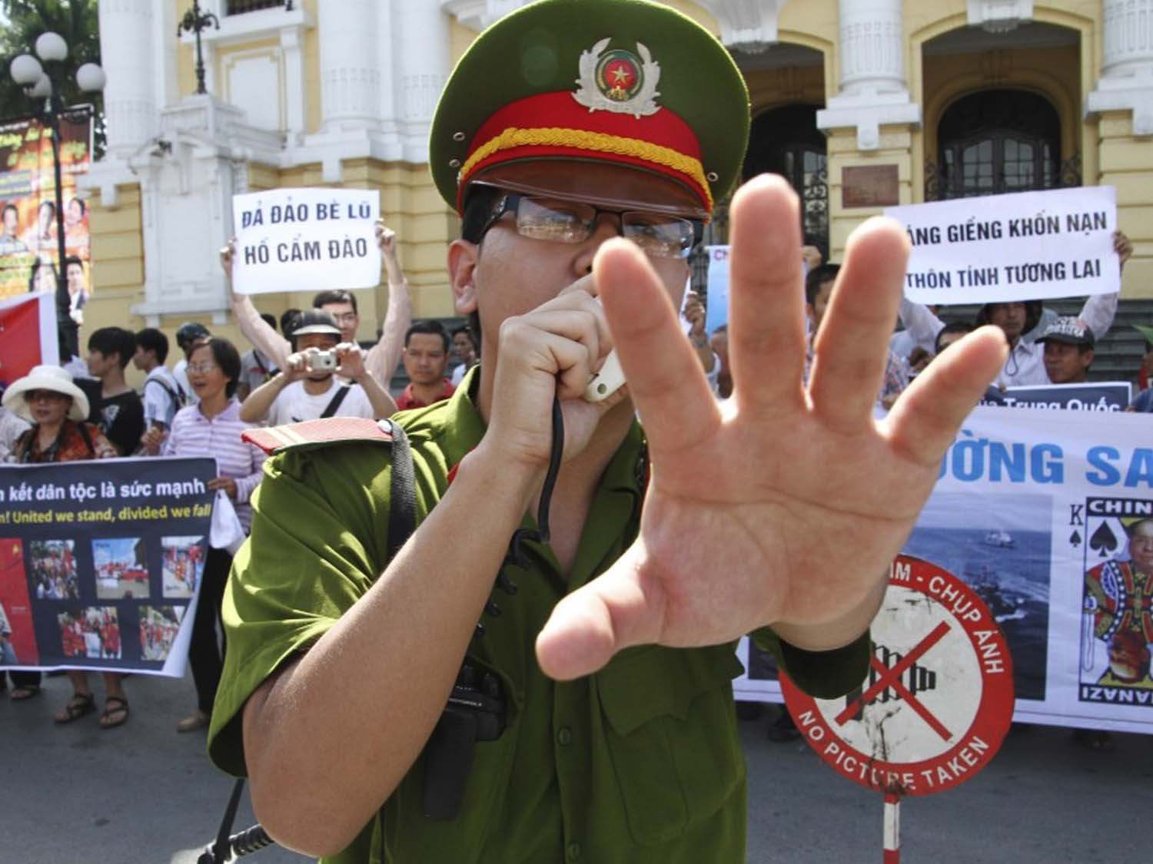
  2. WHAT TACTICS HAS THE VIETNAMESE GOVERNMENT USED TO REPRESS THE EMERGING CIVIL SOCIETY IN VIETNAM?

Slide 12
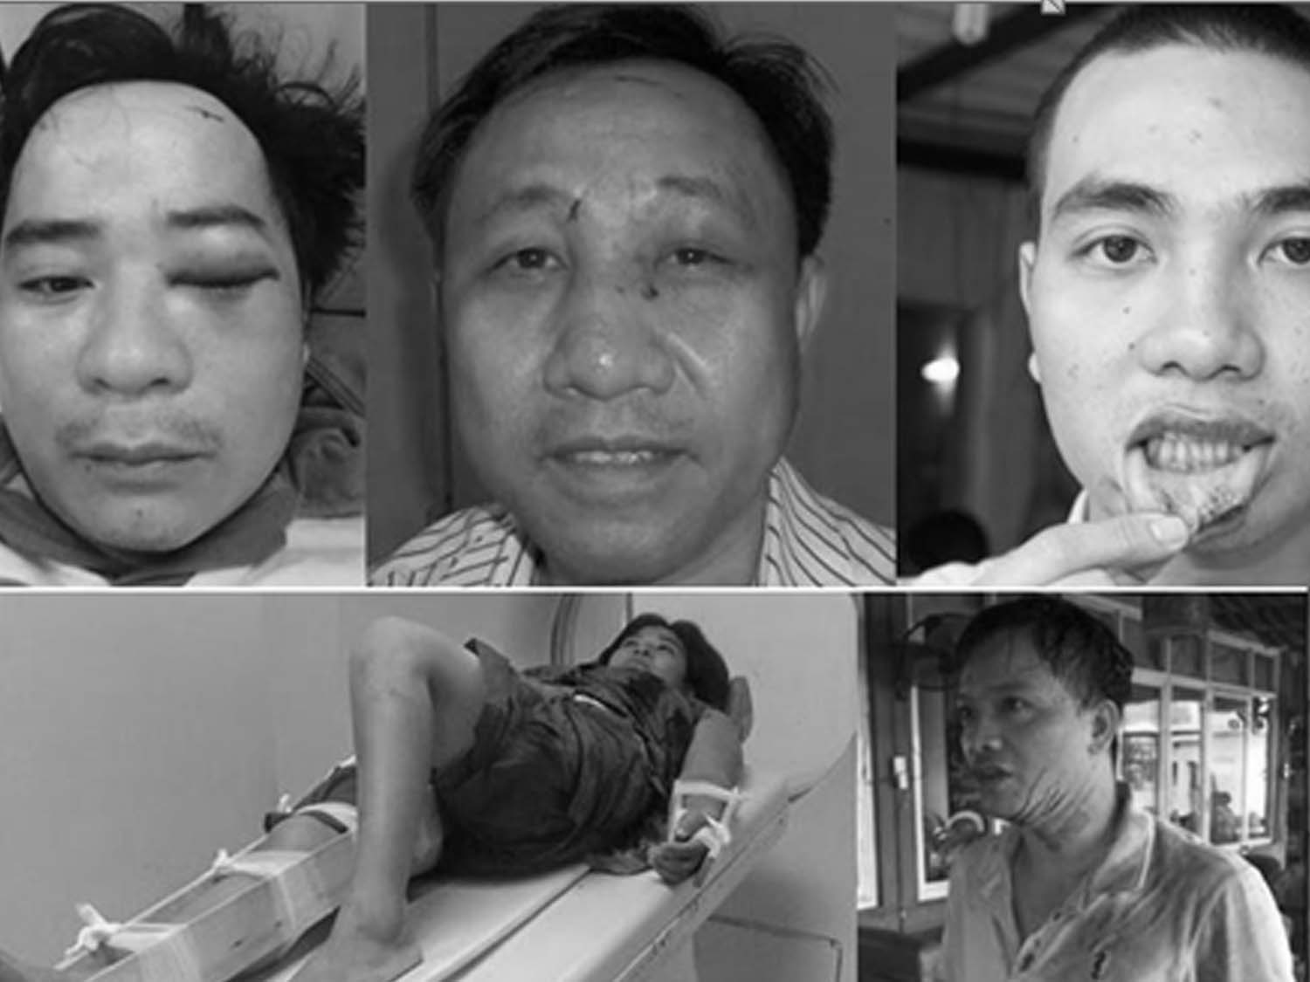
  ABUSING AND PHYSICALLY HARASSING HUMAN RIGHTS DEFENDERS

Slide 13
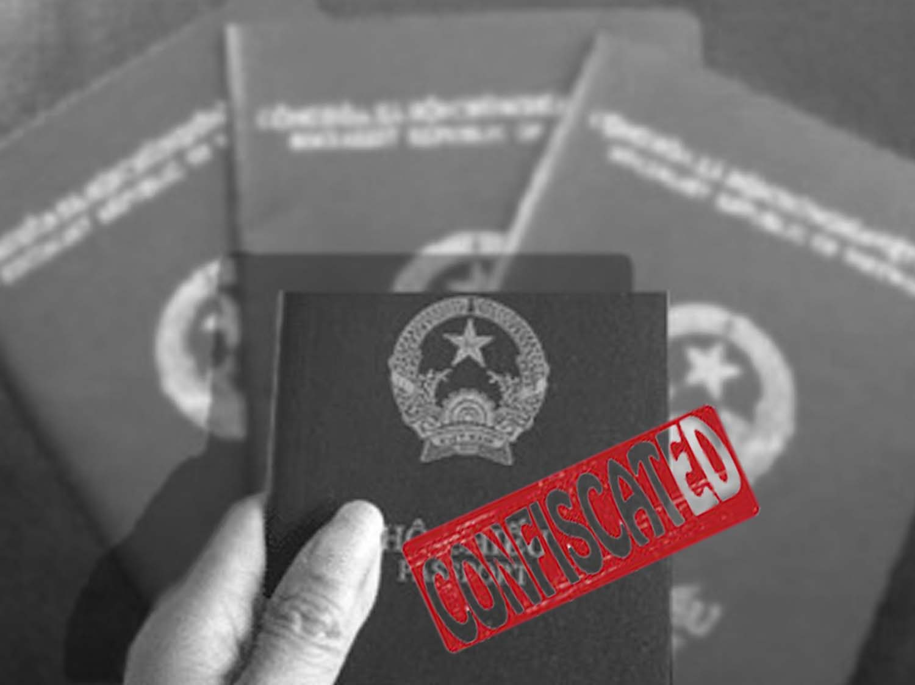
  BANNING HRDS FROM LEAVING VIETNAM (MORE THAN 80 ACTIVISTS)
  BANNING HRDS FROM ATTENDING CONFERENCES OR PUBLIC EVENTS

Slide 14
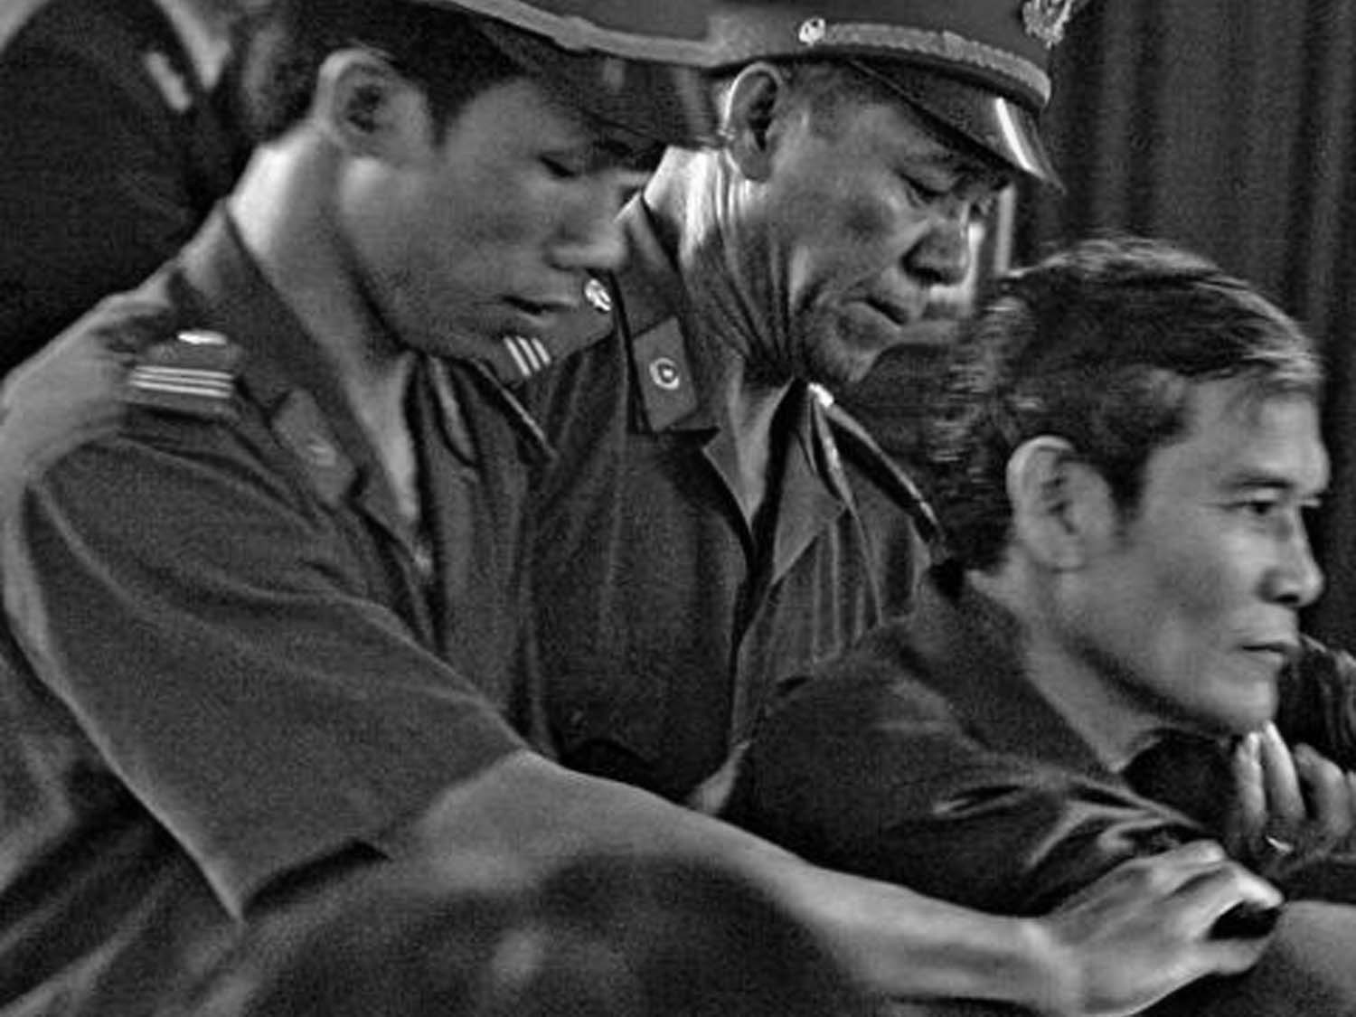
  ARRESTING HRDS (MORE THAN 150 ACTIVISTS ARE CURRENTLY IMPRISONED)

Slide 15
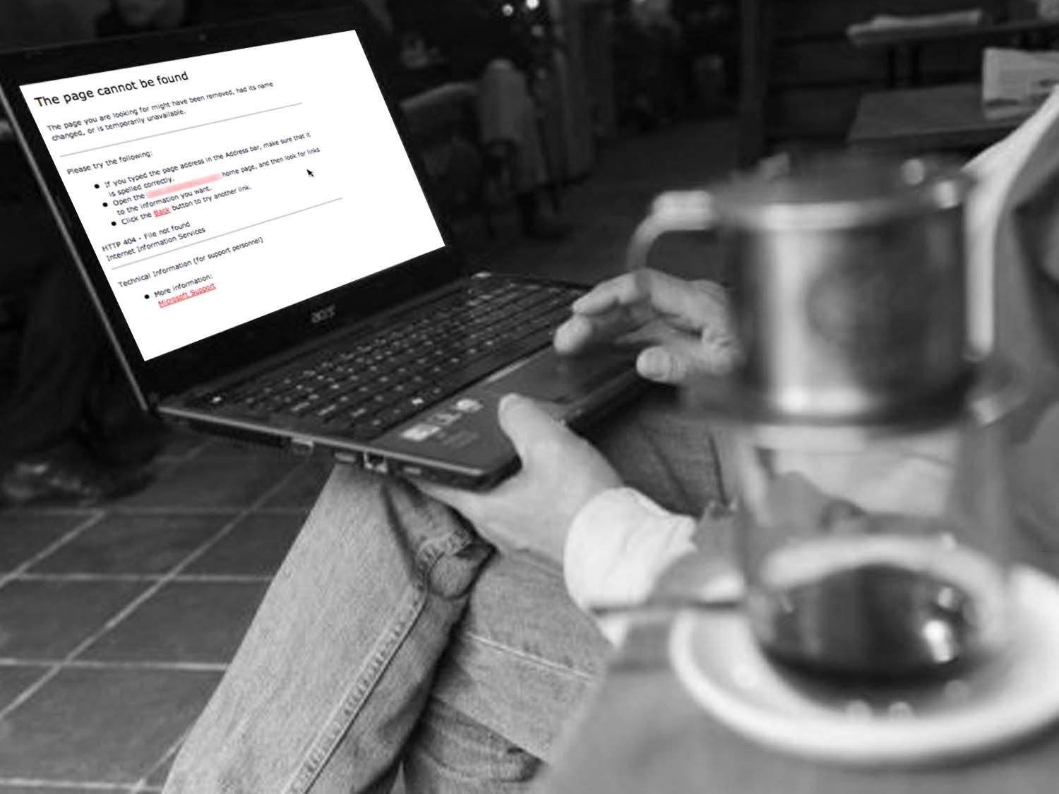
  BLOCKING AND HACKING WELL-KNOWN BLOGS WHICH COVER SOCIAL AND POLITICAL ISSUES.

Slide 16
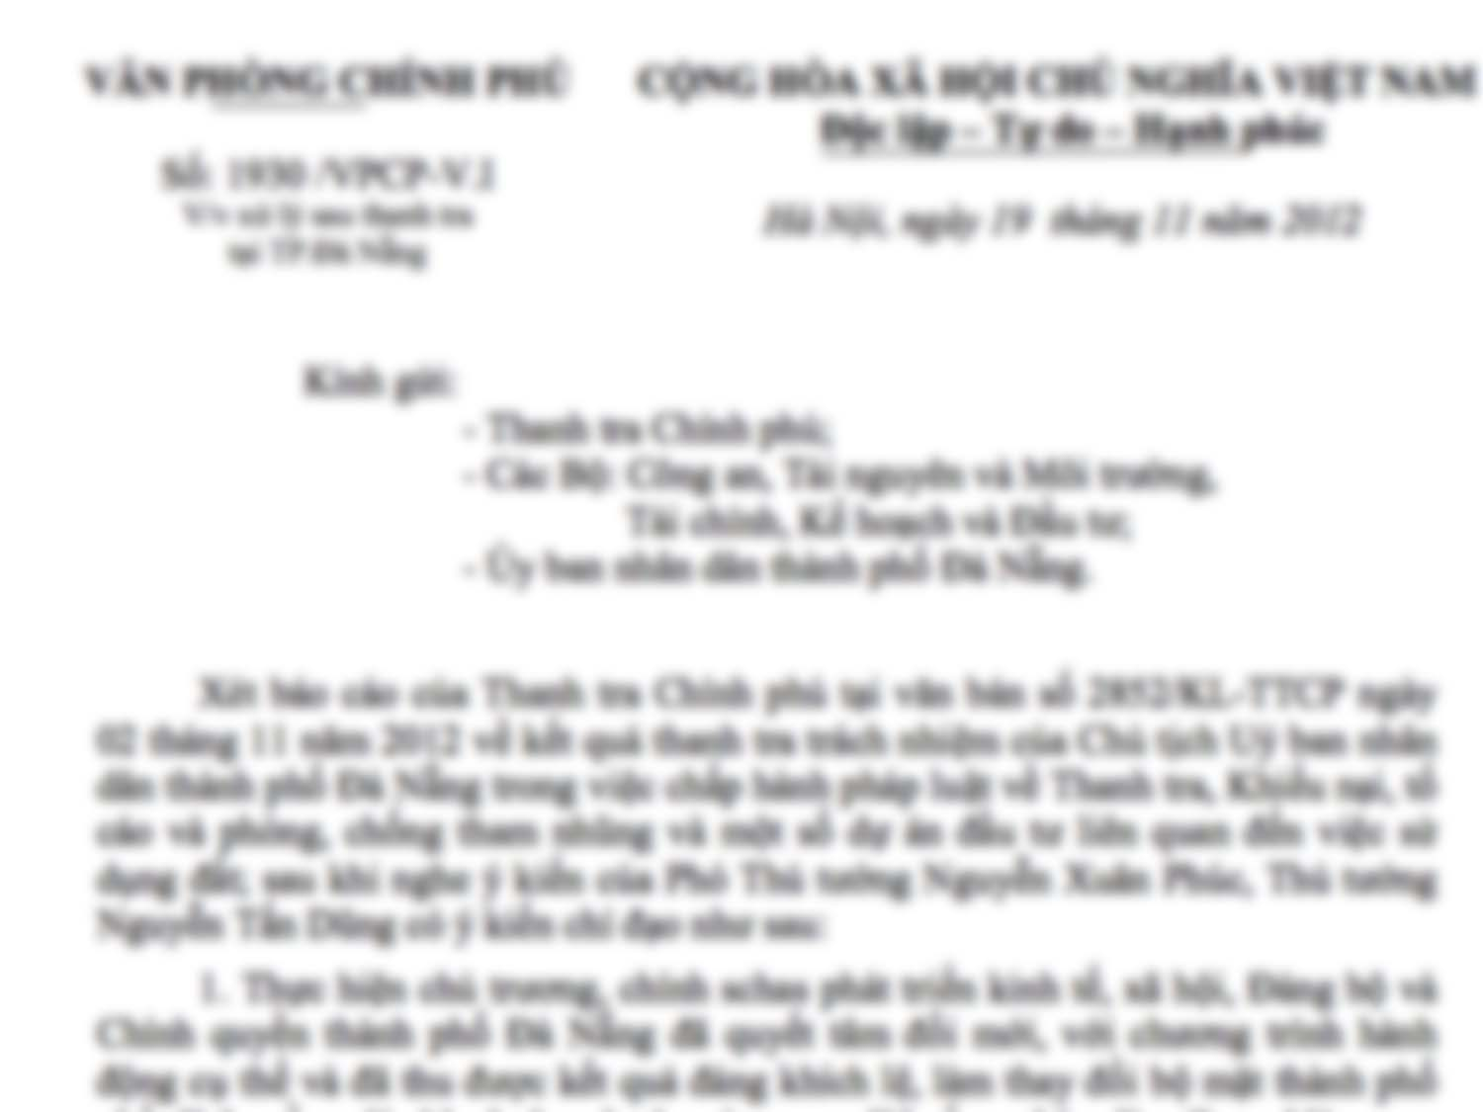
  FINING BLOGGERS UP TO $5000 FOR “CRITICIZING THE GOVERNMENT, THE PARTY OR NATIONAL HEROES”

Slide 17

  ARRESTING BLOGGERS
  (31 CURRENTLY BEHIND BARS)

Slide 18
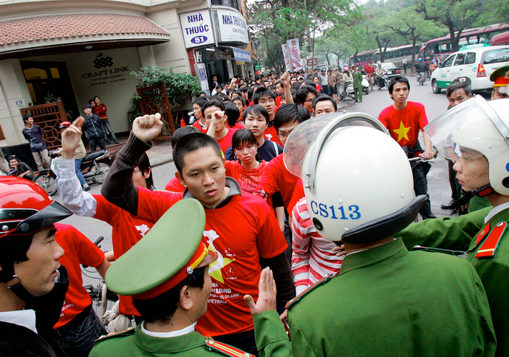
3. HOW CIVIL SOCIETY REACT TO GOVERNMENT TACTICS

Slide 19
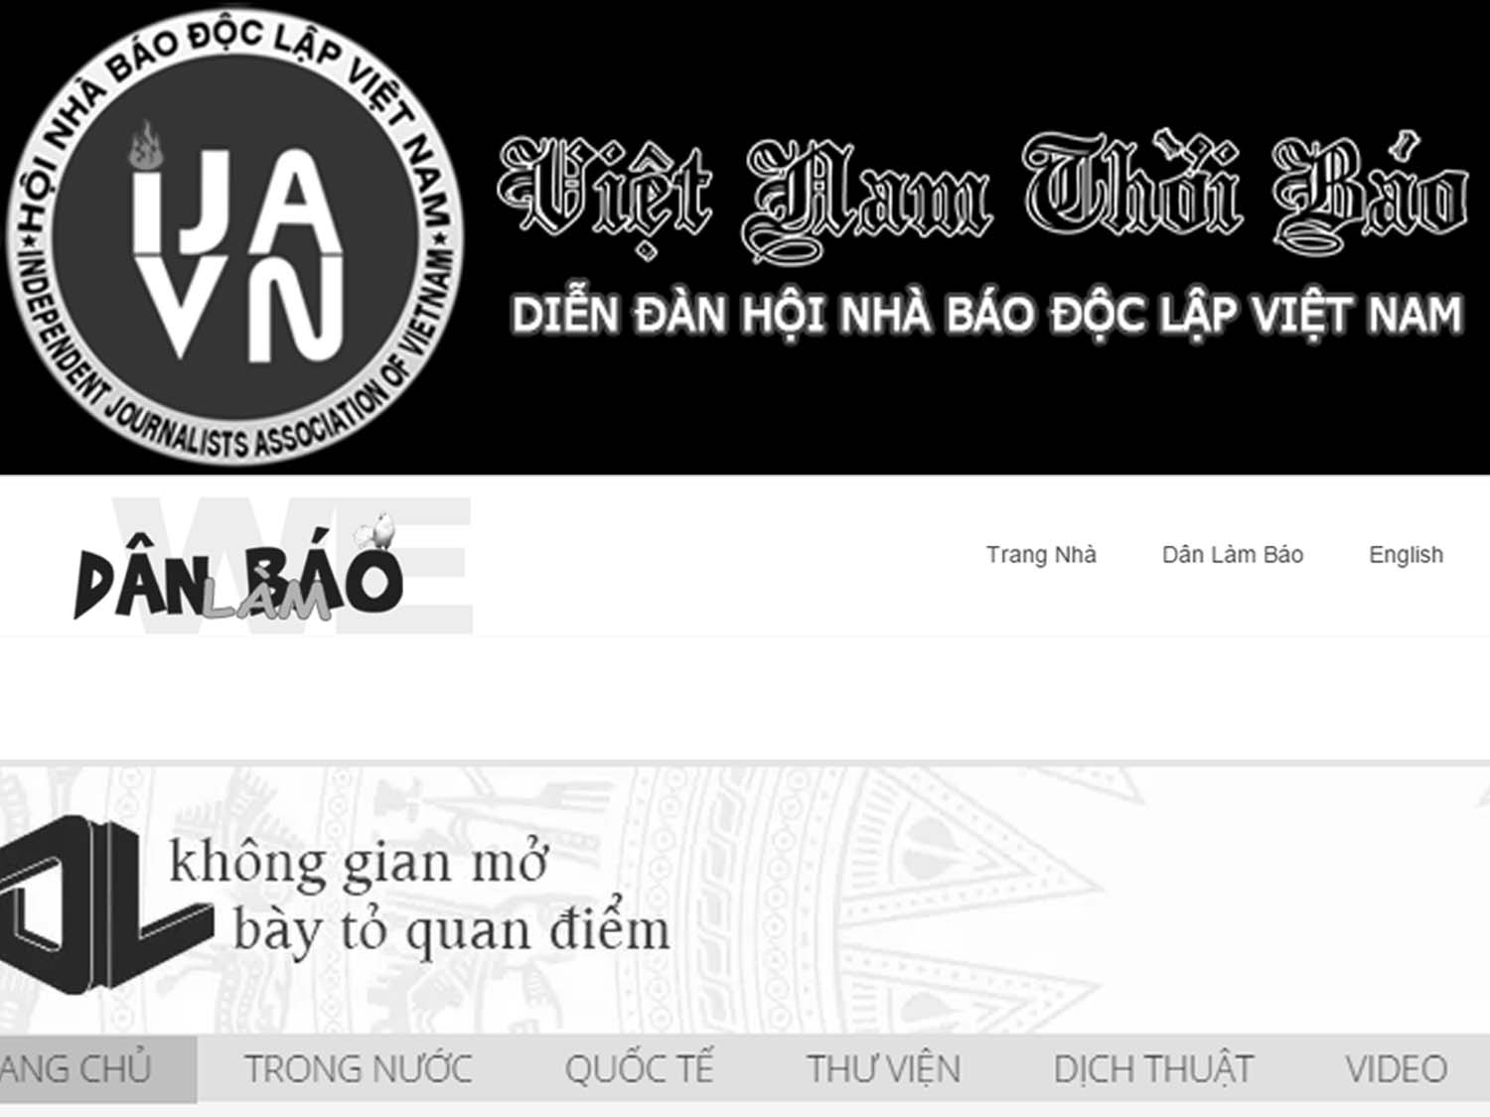
LAUNCHING UNDERGROUND SAMIZDAT-STYLE PUBLISHERS AND INDEPENDENT ONLINE NEWSPAPERS

Slide 20
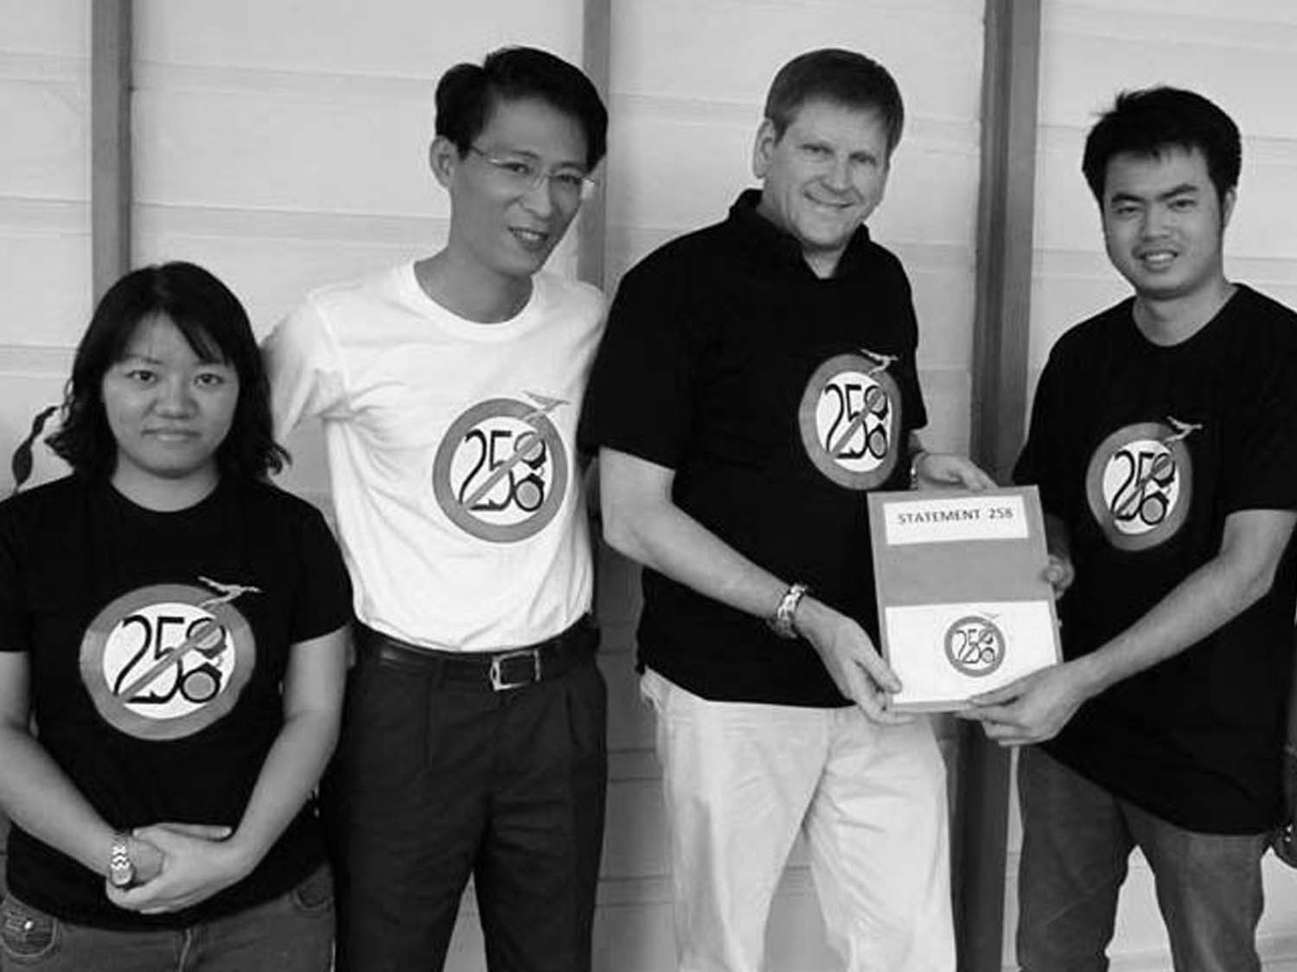
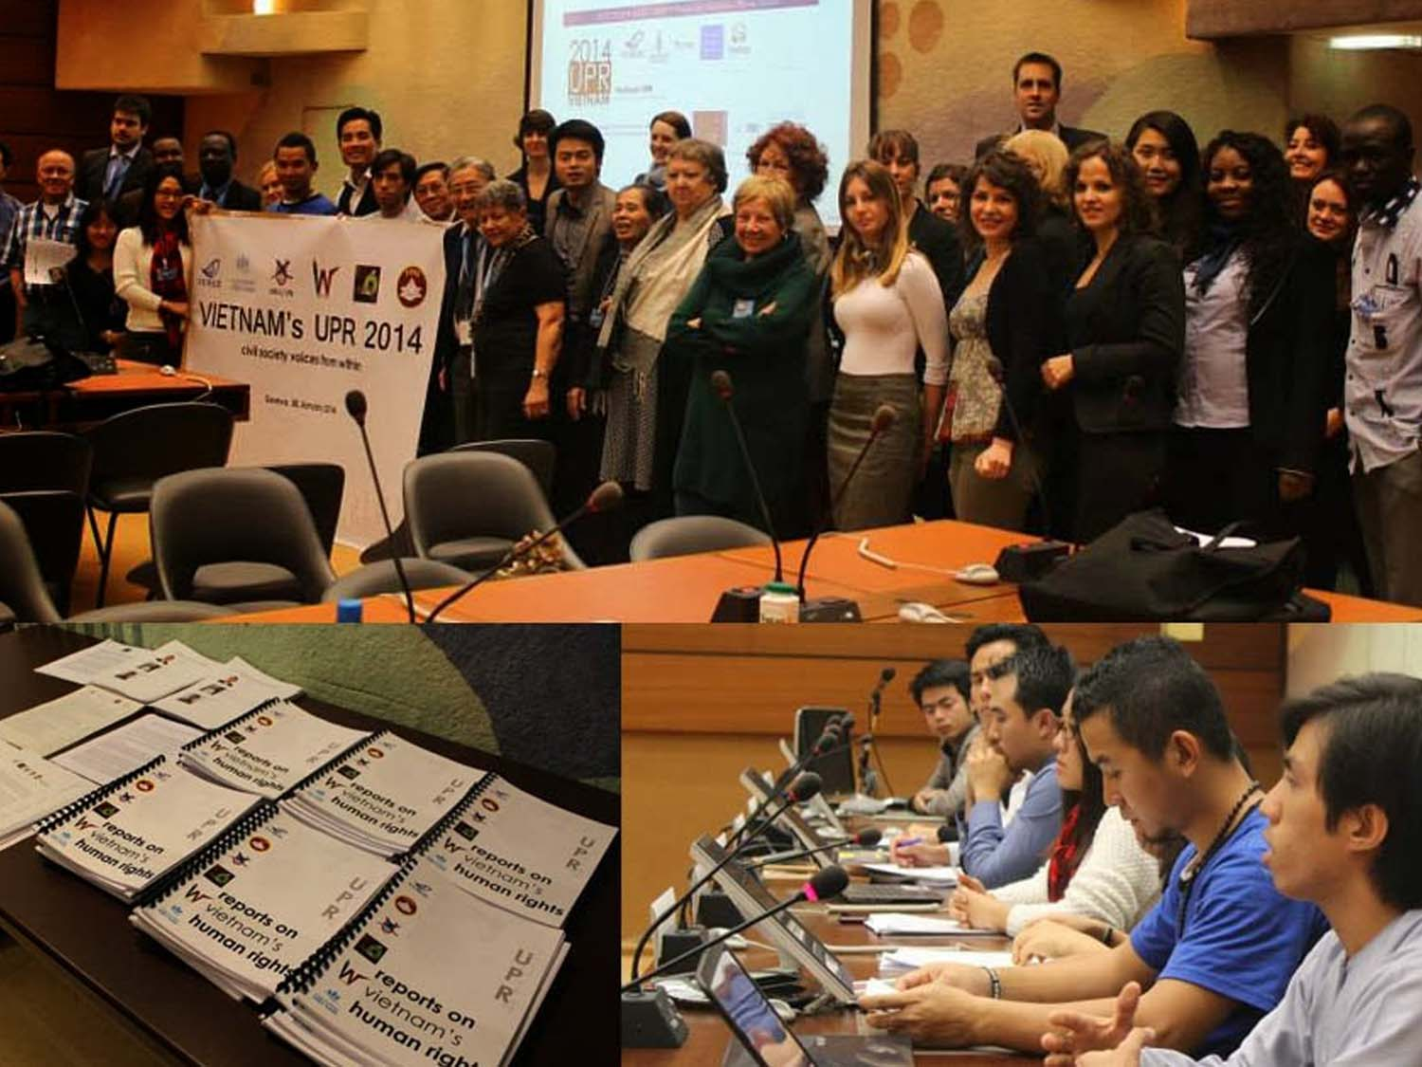
  GENEVA, JANUARY-2014 (VIETNAM UPR)
  LAUNCHING DOMESTIC AND INTERNATIONAL CAMPAIGNS

Slide 21
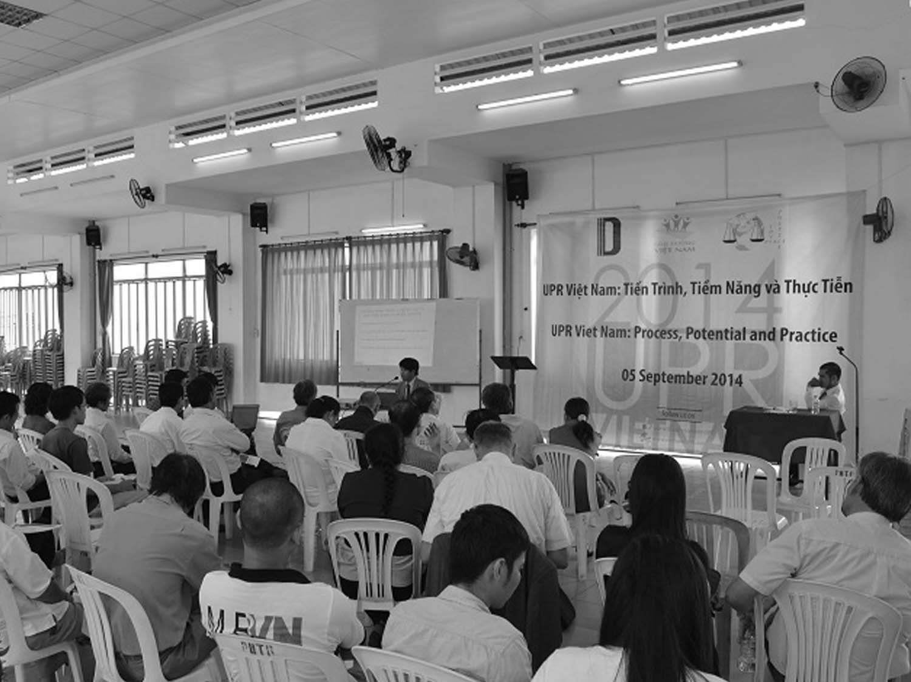
ORGANIZING SEMINARS AND MEETINGS ON HRD ISSUES
  REPORTING TO INTERNATIONAL HUMAN RIGHTS MECHANISMS (UPR, SPECIAL RAPPORTEUR)

Slide 22

TRAINING BLOGGERS IN DIGITAL SECURITY AND SHARING WITH NETIZENS THE TOOLS TO OVERCOME FIREWALLS
  PROVIDING FINANCIAL ASSISTANCE TO HRDS AND POCS

Slide 23
  THANK YOU

