Slide 1

World Movement for Democracy – Eighth Assembly
1-4 November 2015, Seoul, Republic of Korea
Asia Democracy Forum
The States of Democracy in Asia – Challenges and Opportunities for Civil Society
Testimonies from "Democratic Hotspots" in Asia -
Civic Responses to Challenges and Threats and for International Solidarity for Inclusive Democracy for All
2 November 2015
Soe Aung
Burma Partnership

Slide 2
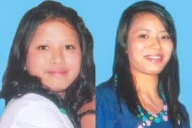
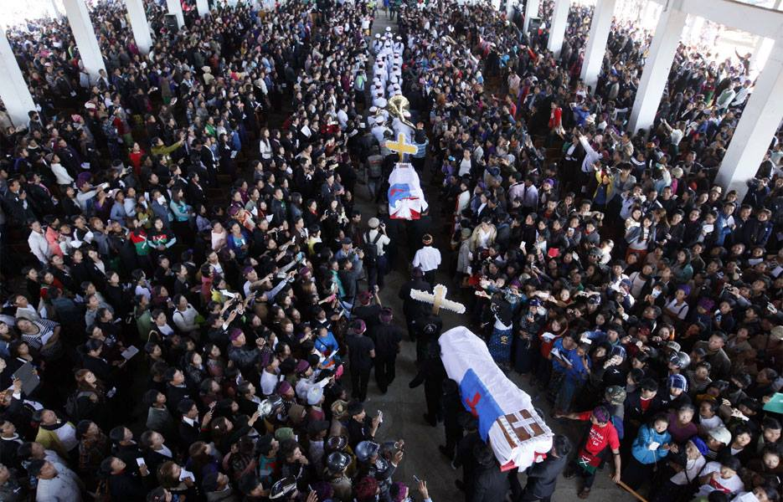
impunity in ethnic and conflict areas: e.g also national and global protests over rape and murder of Kachin women in Jan 2015, on killing of journalist Ko Par Gyi and jailing of U Brang Shawng: Ja Seng Ing's father - he had written to President and NHRC on the death of his daughter

Slide 3
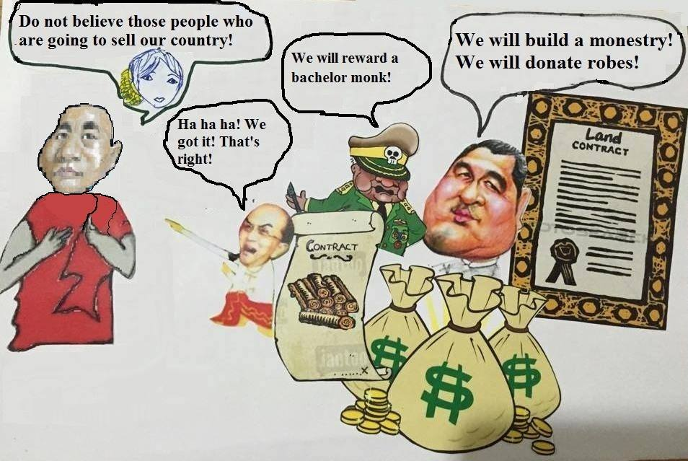

solidarity against extreme racial discrimination Rohingyas and Muslims e.g My friend selfie campaign amongst youth, general advocacy, https://www.facebook.com/myfriendcampaign/?fref=ts
use of humor such as https://www.facebook.com/Six-fruits-136901366656665/ Using cartoons as resistance against violent extremists

Slide 4
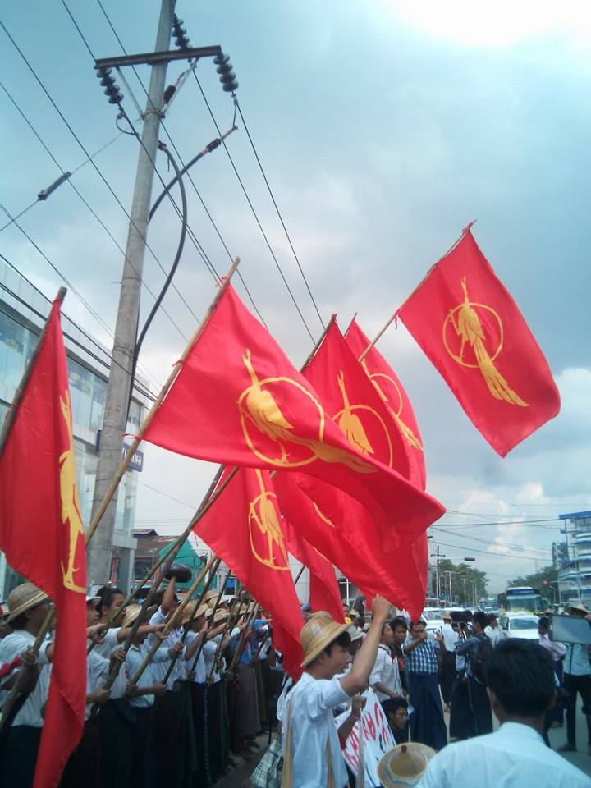
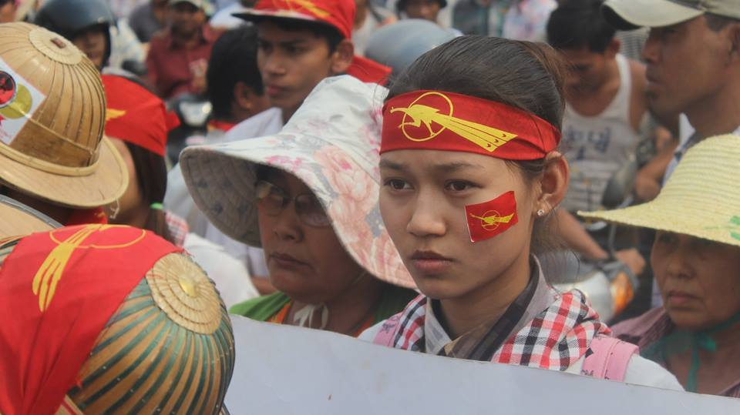
solidarity with students who peacefully protested and marched for increased education budget and independent student unions *latest update: One of the leaders ABFSU Chairperson Kyaw Ko Ko was arrested 4 days ago

Slide 5
Old and new repressive laws in combined infringing rights
Authorities continued to either fail to address, or collude in serious human rights violations, and took steps to undermine the possibility of ‘free and fair’ elections e.g. Special Branch under MoH act confidently in broad day light and put HRDs under intimidation and surveillance and making threats including online (viber, phone, SMS and FB)
Organisation for Protection of Race and Religion (Ma Ba Tha) and use of ‘ordinary people’ intimidation and threat against particularly to women HRDs and peace/interfaith activists and NLD and its supporters e.g. latest attack on NLD election candidate Naing Ngan Lin
Free & fair elections? Restrictions of political space and participation of multiple groups, through formal procedures, mismanagement, or neglect. Multiple flaws continue to undermine the credibility of the process
International community's business interest in Burma that led to "See No Evil and Hear No Evil" mode among international players and HRs is not a priority anymore
Signing of Nationwide Ceasefire Agreement with 8 EAOs but some strong EAOs haven’t done so. Tatmadaw offensives in Kachin and Northern Shan State continued. Civilians suffered more and more due to these fighting

Slide 6
HRs education
Legal aid to HRs cases in detention and court and support to families
Networking and coordination (CSO Forum, HRD Forum, CS Forum on Peace, Land in Our Hands, National Network for Education Reform, etc)
Signature campaign to have constitutional reform
Civil Society to the UN, Vice President to stop military campaign in ethnic areas
International advocacy (UPR, ACSC/APF)
Media advocacy (pressers, Op-Eds)
Request to regional and international civil society orgs, HR NGOs, and MPs to speak out, to hold their governments and companies accountable

Slide 7
Burma Partnership is a network of organizations throughout the Asia-Pacific region supporting the collective efforts of all peoples working towards democracy, peace, and human rights in Burma.

Slide 8
Thank you very much!
Kamsahamnida!
ေက်းဇူးအမ်ားႀကီးတင္ပါတယ္
Follow us on Twitter
@soeaung
@BurmaPartners
Visit our website
www.burmapartnership.org

