Slide 1


The role of UCLG in the international promotion of human rights in the city
Ms. Magali Fricaudet
Coordinator
Committee on Social Inclusion,
Participatory Democracy and Human Rights
United Cities and Local Governments (UCLG)

Slide 2
UCLG and the Committee on Social Inclusion, Participatory Democracy and Human Rights
Two main conditions for Local Government to fulfill their human rights obligations
The need for local government to go further, and to advocate for the right to the city in the New Global Agenda

Slide 3
UCLG and the Committee on Social Inclusion, Participatory Democracy and Human Rights

Slide 4
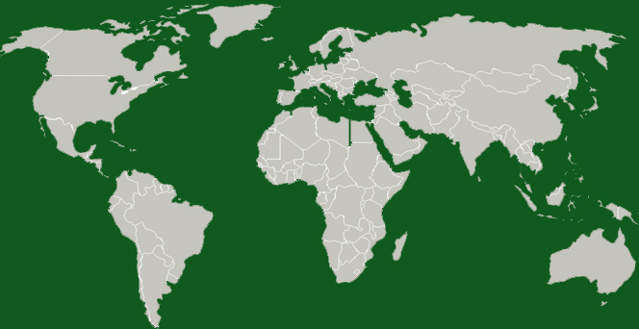
UNITED CITIES AND LOCAL GOVERNMENTS (UCLG)
World organization of LOCAL AND REGIONAL GOVERNMENTS (1000), as well as of their ASSOCIATIONS (112) coming from 140 countries
Represents the voice of LOCAL GOVERNMENTS in the international scene
Foster decentralization and local democracy
Decentralized structure: 7 regional sections / 1 metropolitan section
Africa
Latin America
Asia Pacific
Europe
Eurasia
North America
Middle East and West Asia
Metropolis

Slide 5

COMMITTEE ON SOCIAL INCLUSION, PARTICIPATORY DEMOCRACY AND HUMAN RIGHTS
WHAT?
SOCIAL INCLUSION
Articulate a common voice of LG and foster local policies
PARTICIPATORY DEMOCRACY
HUMAN RIGHTS
ORGANIZING POLITICAL DEBATES
AMONG LOCAL GOVERNMENTS
HOW?
80 Local Government
PROMOTE EXCHANGE
OF INNOVATIVE POLICIES / EXPERIENCES
Academic Sector
FOSTER COLLECTIVE PRODUCTION
OF NEW KNOWLEDGE ON LOCAL POLICIES
5

Slide 6
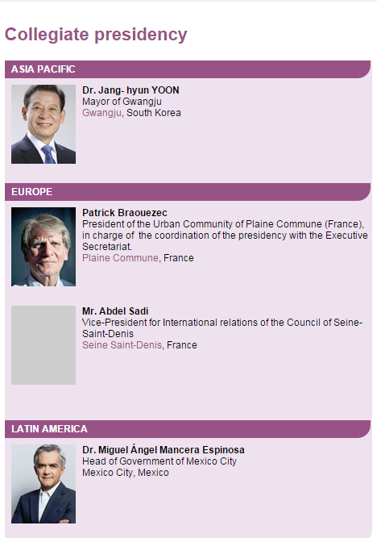

Slide 7
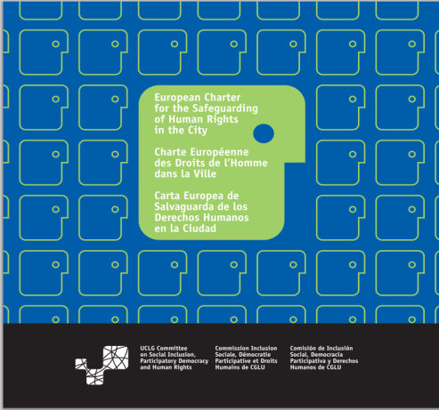
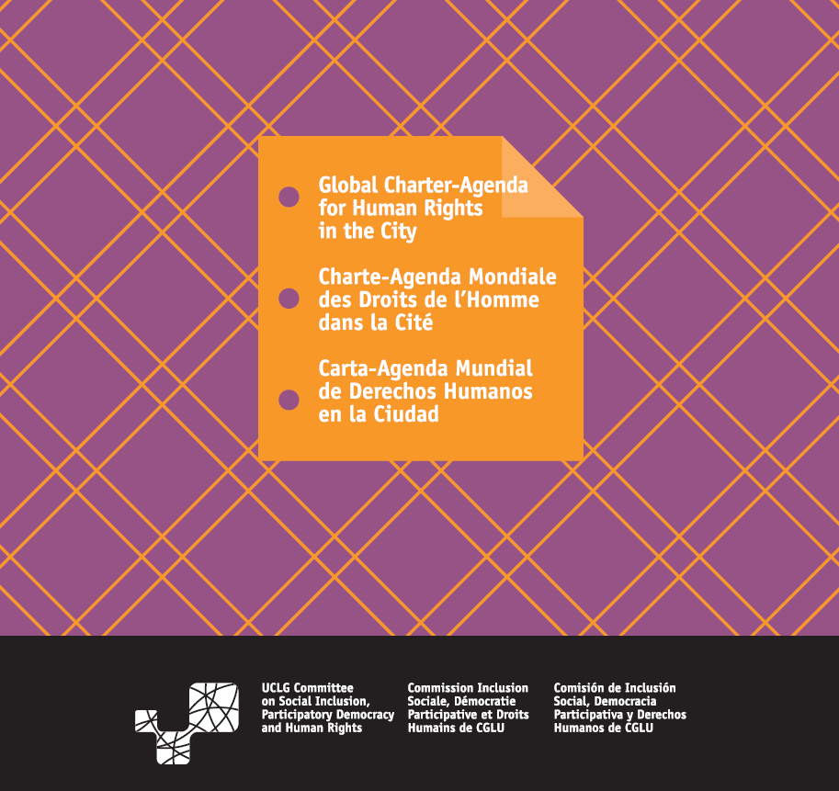
Advocacy Work
Promotion of HR Instruments at local level
European Charter for the Safeguarding of HR in the city, Saint- Denis, 2000
The Global Charter –Agenda for Human Rights in the City CSIPDHR corrdinated its redaction Adopted by UCLG in Florence, 2011

Slide 8

Gathers civil society organizations, Local governments and academic sector to promote the right to the city at local and global level in particular in Habitat III Agenda
http://www.righttothecityplatform.org.br/

Slide 9
2. Two main conditions for Local Governments to fulfill their human rights obligations

Slide 10
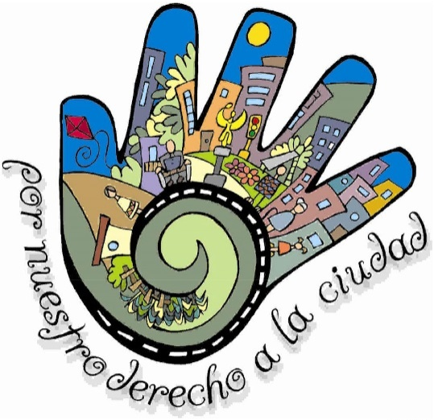
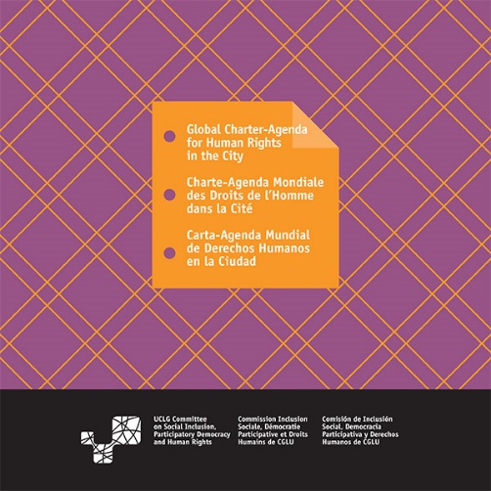

Report: “Role of local government in the promotion and protection of human rights”
Universally recognize the localization of democracy and human rights and the role of the local government in it.
  Human Rights mainstreaming within the administration can foster the commitment of both public servants and citizens.
Strong social contracts at local level which renew the concept of citizenship to address the great challenge of cities to live together
Mexico Charter for the Right to the City
Global Charter Agenda for human rights in the city
Montreal charter of rights and responsibilities
10

Slide 11
Human Rights Mainstreaming
“The city of São Paulo created, in 2013, the Secretariat for Human Rights and Citizenship. Transversal public policies have been adopted to deconstruct a longstanding culture of violence and violation of human rights. São Paulo is working on the promotion of rights of LGBT people, homeless people, children and youth, migrants, elder and other vulnerable sectors of society. Human rights education, the development of policies for a decent work as well as the promotion of the right to the memory and the truth are also examples of its efforts to build a more tolerant society. In contrast to previous repressive experiences with drug users, arm reduction policies have been implemented and they already achieved significant positive results”
Kelly Kumatsu Agopian, Municipal Secretariat for Human Rights and Citizenship, São Paulo City Hall
11

Slide 12

Conditions for Local Governments to respond their HR obligations
DESCENTRALIZATION
strong institutions, with a real autonomy and human and financial resources
Two main conditions for Local Governments to promote and protect Human Rights:
necessity of a REAL PARTNERSHIP WITH CIVIL SOCIETY
It is also very important to strengthen control mechanisms shared with civil society such as Human Rights Committees and observatories, ombudsman, among other good practices.
Instruments like the Global-Charter Agenda should be used like a “Road Map”
12

Slide 13
3. The need for Local Governments to go further, and to advocate for the right to the city in the New Global Agenda

Slide 14
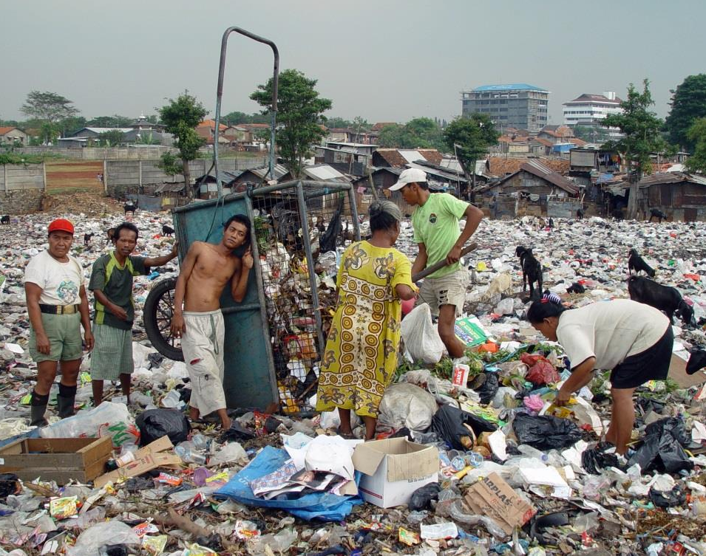
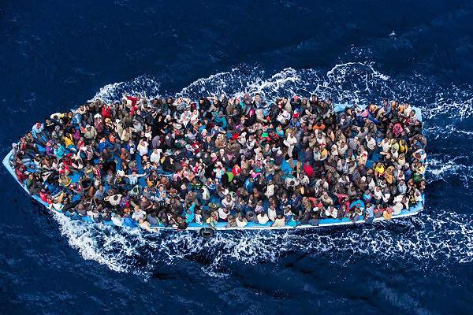
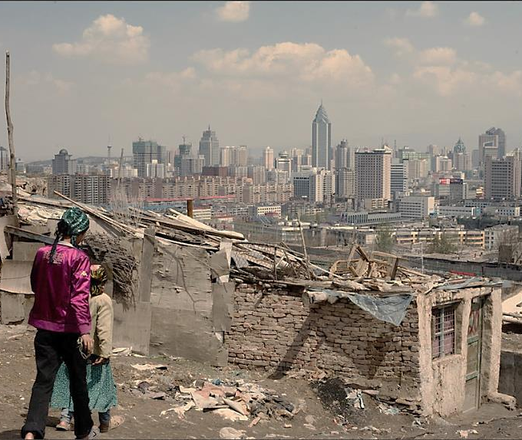
The right to the city : towards inclusive, fair, sustainable and democratic cities
How to build cities for everyone without excluding millions of the poorest people in social and spatial borders?
How to build cities to be spaces for good living, providing opportunities to all the inhabitants?
How to include new migrants ?
What measures could allow local governments to guarantee rights to education, healthcare, healthy environment, employment, participation, culture, security, among others?
How to guarantee access to public services and to improve urban mobility?
How to face climate change that mostly affect informal areas?
How to promote intercultural and intergenerational cities without discrimination, where different worlds can participate?
In 2050, 70% of the world population will live in cities (UN Habitat)
1% of the world population ownes 50% of the wealth (OXFAM Report, 2014)
14

Slide 15
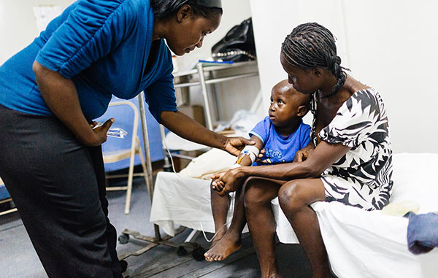
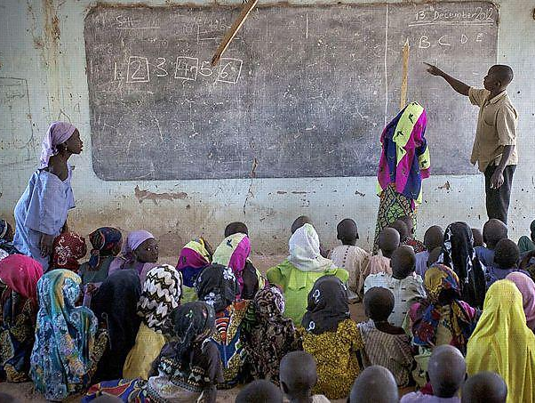

The right to the city
The Right to the City is an individual and collective right for all inhabitants. Cities and their surroundings are considered as spaces for the implementation and fulfilment of rights, in order to share the benefits and to ensure a fair, universal, democratic and sustainable redistribution of resources, wealth, services, common goods and opportunities.
Right to the City as a possible alternative to the present narrative of urban development
15

Slide 16
Legal frameworks and public policies to develop the right to the city
The right to the city through stimulating the occupation of public spaces fosters the encounter of diversity and contributes to put into practice the City Statute, a landmark commitment that asserts the social function and democratic management of common areas of the city. It is important to note that these improvements take advantage of social participation as a method of administration by means, for example, of open dialogues and regular public hearings.”
Kelly Kumatsu Agopian, Municipal Secretariat for Human Rights and Citizenship, São Paulo City Hall

Slide 17
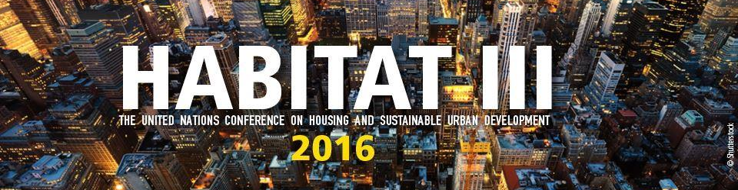
The recommendations of the report and the right to the city must be included in the New Habitat Agenda
In 2016, UN members state will adopt a new Habitat Agenda for the next 20 years.
This agenda must include concrete measures with indicators to allow the public management of cities, in order to plan their development as a common good for all > urban planning under citizens’ control.
If, not, it would be quite impossible for Local Governements to face the Human Rights Violations of exclusive cities.
17

Slide 18
Thank you very much for your attention!
18

Slide 19


Committee on Social Inclusion, Participatory Democracy and Human Human Rights
United Cities and Local Governments
Avinyó, 15 - 2ª Planta. 08002 Barcelona, Spain
Tlf: +34 93 342 87 70
www.uclg-cisdp.org
m.fricaudet@uclg.org

