Slide 1


UN HRC-30 Side Event on
Local Government and Human Rights
12:30-14:00,18 September 2015,
Palais des Nations, Room XXIV, Geneva
Gwangju World Human Rights Cities Forum (WHRCF) and Korea
Anselmo LEE alee7080@gmail.com
Executive Director, Korea Human Rights Foundation (KHRF)
Co-convener, Asia Democracy Network (AND)

Slide 2
Contents
Context 2015
What is “Human right city”
Structure and components
Human Rights Cities in South Korea
Lessons and Challenges
Gwangju World Human Rights Cities Forum (WHRCF)
Suggestions

Slide 3
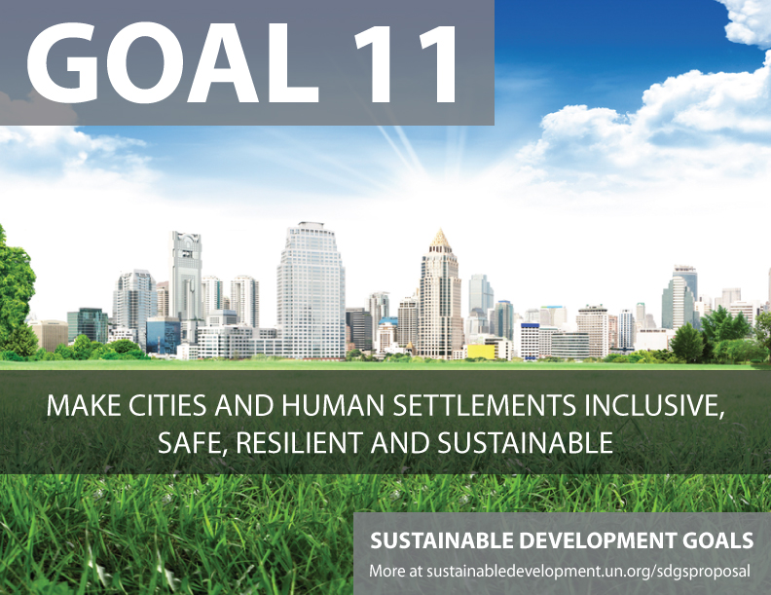
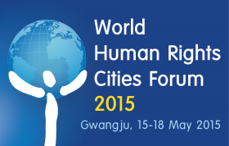
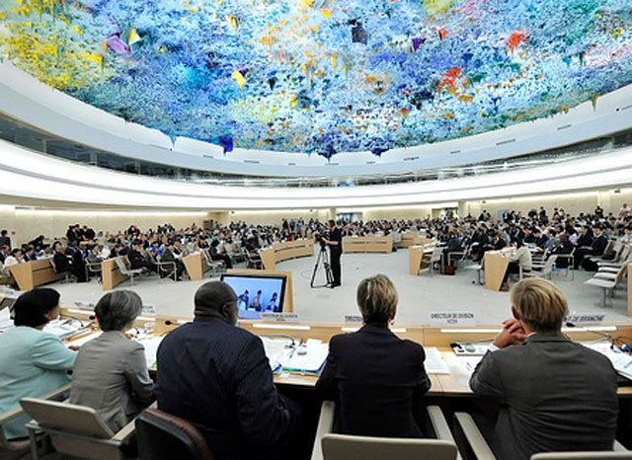

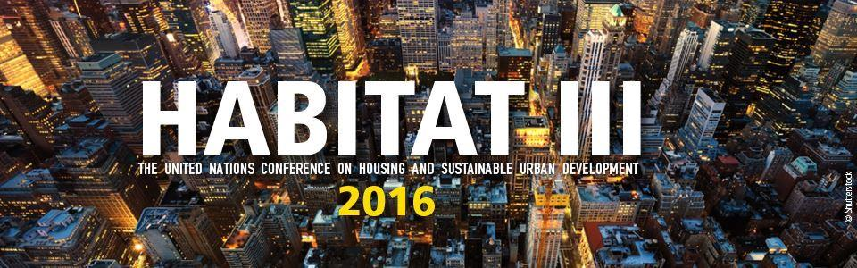

Slide 4
Context 2015
5th World Human Rights Cities Forum (Gwangju, May 15-18 2015)
Final Report on the role of local government in the promotion and protection of human right by UN HRC (A/HRC/30/49)
Adoption of 17 Sustainable Development Goals (SDGs) by the UN GA
  No 11. Make Cities and Human Settlements Inclusive, Save, Resilient and Sustainable
UCLG World Council (Paris, 4-6 Dec. 2015)
UN HABITAT III (Ecuador, Oct. 2016)

Slide 5
Framing and Perspectives
Local, Sub-national, de-centralized, autonomous, etc.
Local Government, Governance, Democracy, etc.
Human Rights City (Rights of the City, Human Rights in the City, Right to the City, etc.)
Urban citizenship, Glo-cal citizenship, etc.
Localizing international human rights vs.
Globalizing human rights from below

Slide 6
Human Rights City
From Gwangju Declaration on a Human Right City (May 17, 2011)
‘Human rights city’ was defined as ‘both a local community and a socio-political process in a local context where human rights play a key role as fundamental values and guiding principles’.
‘Human rights city’ was understood as ‘human rights governance in a local context’ where local government, local parliament, civil society, private sector organizations and other stakeholders work together to improve quality of life for all inhabitants in a spirit of partnership based on human rights standards and norms.
‘Human rights city’ also means, in practical terms, that all inhabitants, regardless of race, sex, color, nationality, ethnic background and social status, and in particular minorities and any other vulnerable groups who are socially vulnerable and marginalized, can participate fully in decision-making and policy-implementation processes that affect their lives in accordance with such human rights principles as non-discrimination, rule of law, participation, empowerment, transparency and accountability.

Slide 7
Human Rights Cities in South Korea
As of May 2015, Human Rights Ordinance enacted
  13 out of 17 Metropolitan Self-Government (77%)
  74 out of 246 Local Self-Governments (30%)
Gwanju and Seoul Metropolitan City are two leading cities with various programs and initiatives:
  Human Rights Office
  Municipal Human Rights Commission
  Remedy procedures: Ombudsman
  Human Rights Action Plan

Slide 8
Structure and Components
Structure | Components
Standards | Local (Municipal) Human Rights Charter (Declaration) Human Rights Ordinance – Sectoral or Thematic Human Rights Ordinance – basic or framework Guiding Principles on Human Rights City Implementation Guideline for Human Rights City Human Rights Code of Conduct
Institution | Human Rights Committee, Local Council (Parliament) Local Human Rights Commission (Committee) Ombudsman Human Rights Office (Bureau) Human Rights Center
Policy | Human Rights Baseline Study Human Rights Local Action Plan (LAP) Human Rights Impact Assessment Human Rights Indicators Human Rights-based Participatory Budgeting Human Rights audit Human Rights Education or Training

Slide 9
Why HRC in S. Korea?
‘Trickle-down effect’ – human rights awareness and mainstreaming, domestic implementation of human rights, etc.
‘Top-down’ – Policy recommendation by the National Human Rights Commission of Korea in April 2012
‘Bottom-up’ : joint initiative of grassroots and human rights movement/community
‘Human right city’ as new and innovative paradigm for municipal administration or governance
New approaches to address urban problems (housing, transportation, public space, etc.)

Slide 10
Challenges
Citizens’ participation – “Free, Active and Meaningful” participation by ordinary citizens
Legal foundation and legitimacy of the human rights city
Ordinance, charter and national legislation on de-centralisation or local autonomy in terms of budget and human resources.
Coordination between national (central, federal) government and sub-national (local) government and Cooperation among local (urban-rural) governments.
Human rights-based approach (HRBA) to municipal administration or governance (e.g. human rights action plan, human rights indicators, human rights impact assessment, etc.)
Continuity and sustainability of human rights city program – collective ownership and leadership by mayor, local council, civil society, etc.

Slide 11
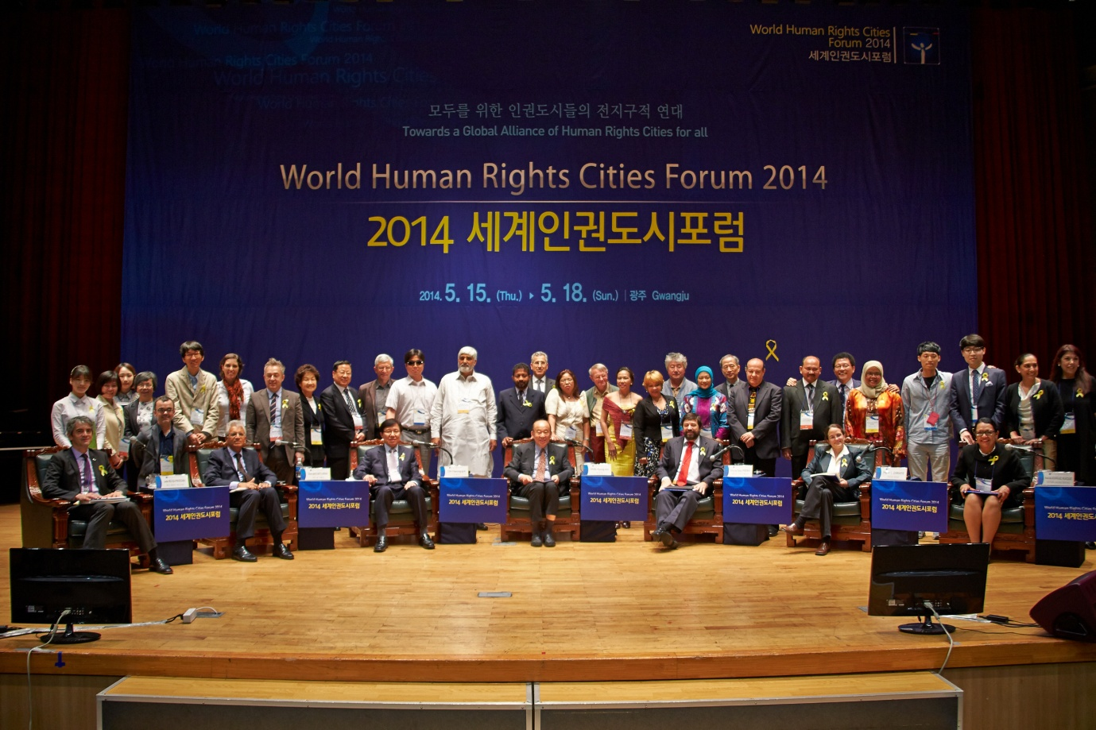
Gwangju WHRCF since 2011
Kimdaejung Convention Center
16 to 18 May

Slide 12
Gwangju WHRCF since 2011
Strategy to implement the election pledge to “make Gwnagju a human right city” in 2011
A global multi-stake holder forum among local government, council, civil society, researchers, etc.
About 500 participants including 400 local and 100 from other countries.
Co-organized by Gwangju Metropolitan City and related institutions and organizations including the Korea Human Rights Foundation (KHRF)
Co-Chairs of the Organizing Committee:
  Amb. Keyongseo Park, The First Human Rights Ambassador at Large (2011 to present)
  Janghyun YUN, Mayor of Gwangju (2015-2019)
  Untae KANG, Former Mayor of Gwangu (2011-2014)
Gwangju Declaration on Human Rights City (17 May 2011)
Gwangju Guiding Principles for a Human Rights City (Gwangju Compact) 17 May 2013
Whitebook on Human Rights City in South Korea (English / Korean) 2014

Slide 13
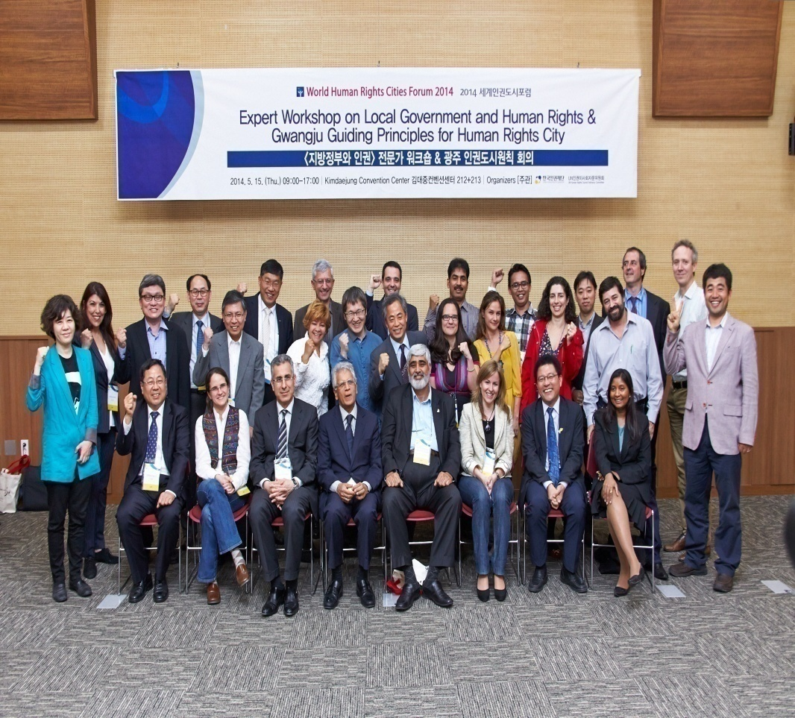
Expert Workshop
Held in Gwangju twice on15 May 2014 and 2015
Organized by the UN HRC AC and KHRF with the support from Gwangju Metropolitan City
To support the work of the UN HRC Advisory Committee in preparing for the report on the role of local government and human rights in accordance with the adoption of the resolution at the UN HRC in 2013.

Slide 14
Suggestions
More good practices
“Side-event” to “Main-event” at the UN HRC
Need for guiding principles and implementation guidelines (e.g. Guiding Principles on Business and Human Rights)
Regular multi-stake holders forum by UN – global and regional (e.g. UN Global Forum on Business and Human Rights)

